Slide 1
Aeronautical Decision Making
Gerald A Smith, DMD, CFIG
NESA Spring Safety Meeting 5/11/2019

Slide 2
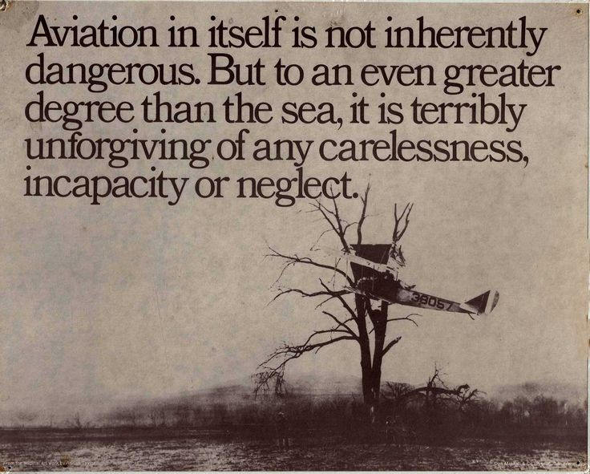

Slide 3
FAA Definition:
a systematic approach to the mental process used by pilots to consistently determine the best course of action in response to a given set of circumstances.

Slide 4
3 Key Pieces to the Puzzle:
Situational Awareness
Decision Making
Self-Discipline

Slide 5
Situational Awareness

Slide 6
Situational Awareness: Obstacles
Ignorance
Fixation/Distraction
Overload
Fatigue/Stress
Complacency

Slide 7
Loss of Situational Awareness: Warning Signs
Confusion
Getting behind the glider
Close Calls

Slide 8
Improving Situational Awareness
Pre-plan: decrease workload
Proficiency
Continue Learning
Prioritize
Fly within your limits (Personal Minimums)

Slide 9
Decision Making Risk vs Reward

Slide 10
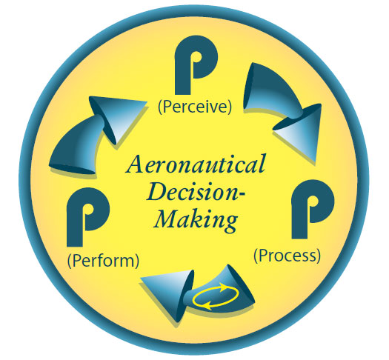
Decision Making Model

Slide 11
Obstacles to Decision Making
Ignorance
Urgency
Unstructured Process
Hazardous Attitudes

Slide 12
5 Hazardous Attitudes
Anti-Authority
Impulsivity
Invulnerability
Macho
Resignation

Slide 13
Warning Signs of Poor Decision Making
Outcome based on luck
Close calls
Scare yourself or others
Insufficient Planning

Slide 14
Improving Decision Making
Gain Knowledge
Use a systematic approach
Plan Ahead
Reinforce good decisions

Slide 15
Self Discipline

Slide 16
Self-Discipline: Obstacles
Peer pressure (overt and covert)
Goal Fixation
Complacency

Slide 17
Self-Discipline: Improving
Don’t Revise Limits in the Air
Be flexible but don’t rationalize
Avoid Complacency

Slide 18
Personal Limit Considerations
Maximum wind, gusts and cross wind for takeoff: __________
Minimum altitude for 180 turn back: ___________
Lowest thermalling height above the ground: __________
Sleep before flight: ___________
Alcohol before flight: __________

Slide 19
Personal Limit Considerations
Go with an instructor if haven’t flown within: _______
Minimum planned altitude over airport: ________
Safety factor for glide ratio calculations: ____________
An airport within gliding distance: ___________
Others? _________

Slide 20
Summary
3 Elements of Aeronautical Decision Making:
Situational Awareness
Decision Making
Personal Discipline

Slide 21
Summary
Consciously use rational values for aviation decisions:
Data driven analysis, analytic thought, safety in mind, what is the right thing to do… this is done on the ground before flying
Avoid Emotional values for aviation decisions; especially while Airborne:

Slide 22
Summary
Consider and write down your Personal Limits
Stick to them
Revise when appropriate

Slide 23
Summary
Fly!

