Slide 1
Spring Reminders: Currency vs. Proficiency
NESA

Slide 2
Current vs. Proficient
We are all looking forward to the upcoming season;
Spring often offers some fantastic soaring and “strong” conditions;
Are we ready?
Our ships have been tucked away for the winter and equally, so have we…

Slide 3
Current vs. Proficient
In 1901 Wilbur Wright stated that “practice is the key to the secret of flying”;
Ever since we have recognized the importance of maintaining proficiency;
The FAR’s provide some regulatory guidance on the required “minimum” practice, i.e. currency;
Our club rules provide additional guidance with respect to minimums for the use of club equipment;

Slide 4
Current vs. Proficient
Human factors tell us that retaining previously acquired skills is dependent upon several factors
The “Law of Exercise” (most repeated/best remembered);
The “Law of Recency” (things recently performed are more readily remembered);
These factors are the drivers behind why the FAR’s include the “currency”/recency of experience requirements they do.
Our winter time-out means many of us may be lacking in that recent exercise of skills required for retention.

Slide 5
Current vs. Proficient
Before you fly club ships we require a spring check flight;
Before you fly your own ship solo you need, well technically only a current flight review within 24 months;
Before you carry passengers you need “Current” recency of experience, i.e. have 3 take-off’s and landings within 90 days;
If you are a previously soloed student your 90 day solo endorsement most likely will have expired and you will need to fly with an instructor and obtain a new one;
If you are a transition pilot holding a certificate for another category of aircraft but are student glider pilot you need a current flight review in a category for which you are rated.

Slide 6
Current vs. Proficient
These FAR and club “Currency” requirements may make you legal to launch off into the gusty conditions of the first strong spring soaring day, but are they sufficient to make us “Proficient” to do so safely?
Perhaps, perhaps not. We all have different experience; some of us actually flew during the winter; some of us have many hours, some of us just got our licenses in the fall then immediately hung up our wings for the winter;

Slide 7
Current and Proficient
Remember that by definition
“Proficiency” means performing a skill with “expert correctness”;
Currency only indicates being up to date or occurring within a recent period of time.
We need to be both current and proficient to fly safely in challenging conditions such as strong spring soaring conditions;

Slide 8
Current and Proficient
Lets all exercise good ADM this spring, manage our Risk and not “make Junk”.
Are you “Proficient” for the flight you plan to undertake, consider your currency and experience, the aircraft you are about to fly and the conditions of the day.
In other words…think P.A.V.E. and manage your risk.
If it’s your first day out and conditions are breezy or gusty, ask yourself if it really is the day for your first flight of the season. Exercise good ADM.
If you’re rusty, take a couple of extra flights with an instructor.
Factor your Rustiness into your early season personal minimums.
Set your Personal Minimums for early season conservatively.

Slide 9
Scenarios

Slide 10
Scenarios

Slide 11
Scenarios

Slide 12
Use IMSAFE for Pilot

Slide 13
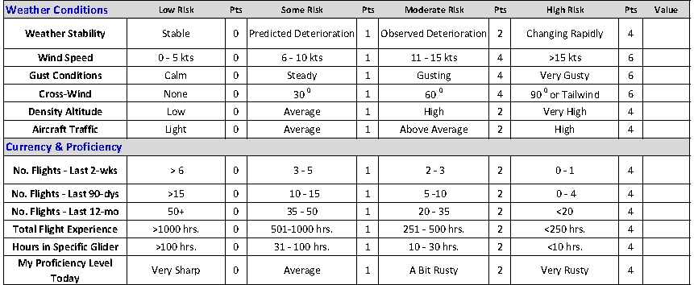
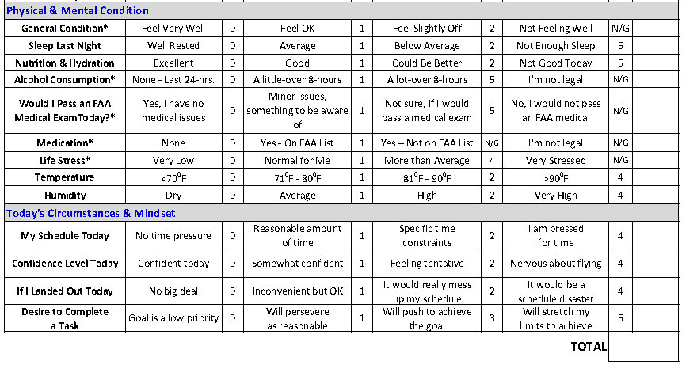
PGC Risk Assessment Matrix

Slide 14
PGC Risk Assessment Matrix
This is a fairly formal risk assessment example and we are not asking you each to complete one today, however:
It contains good examples of different factors that contribute to risk and should factor into your thinking. They are worth reading and thinking about;

Slide 15
Summary
Most of us have not flown in a while;
Make sure you have the regulatory and club requirements met;
The Club rules require you to take a spring check-flight with an instructor before flying club equipment;
The club recommends you take a Spring check-flight even if you fly your own ship (this will be mandatory next season when NESA takes over as the tow provider)
Exercise good ADM.
Think through the P.A.V.E. factors and confirm that you are safe to fly your planned mission given todays conditions;
Set conservative early season personal minimums and adhere to them;
If you have any doubts talk to one of the club instructors and/or consider taking a flight with them;
Have a safe and fun flying season!

Slide 16
Lets have a safe & fun Season
NESA CFIG’s
Jerry Smith
Dave Carton
Alasdair Crawford
Bill Batesole
Brian Xander
Chris Giacomo
Charlie Freeman
Daryl Smith
John Graziano
John Williams
Will Dismukes
Mark Foley

