Slide 1
Safe Launch & Wing Running

Slide 2
Wing Running
Safety Considerations for Launching procedures

Slide 3
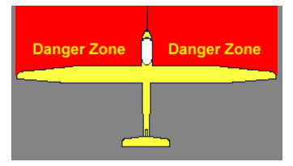
Launching
Wing runner should be aware of all hazards once glider is attached to the tow rope

Slide 4
A recent incident
“Yesterday during a launch there was some miscommunication among the various parties:
The launch was proceeding,
The slack was out of the rope and the tug beginning to accelerate,
But, the wing runner was still in front of the glider.
I'm not sure whether he was trying to stop the launch, or he never thought it was happening, but he was concerned about a glider that was about to enter the pattern.
The pilot was focusing on the tug which was powering up, and became aware that the wing runner was in the way when he felt a bang and the glider swerved.
He pulled the release and looked over to see the runner in the midst of a low-level aerobatic maneuver over the top of the wing.
Luckily no one was hurt and nothing was damaged, but you can imagine it was an upsetting situation for those involved.
The tug continued the takeoff and proceeded around the pattern”
(Taken from an email sent out by the president of another Northeast glider operation after a launch incident).

Slide 5
So, It can happen...
Miscommunication
Launch initiated
Wing runner not clear of wing
Glider pilot focused on tug
Low level aerobatics over the wing
Luckily, no damages or injuries
Notes:
Yesterday during a launch there was some miscommunication among the various parties.
The launch was proceeding,
The slack was out of the rope and the tug beginning to accelerate
but the wing runner was still in front of the glider.
I'm not sure whether he was trying to stop the launch, or he never thought it was happening, but he was concerned about a glider that was about to enter the pattern.
The pilot was focusing on the tug which was powering up, and became aware that the wing runner was in the way when he felt a bang and the glider swerved.
He pulled the release and looked over to see the runner in the midst of a low-level aerobatic maneuver over the top of the wing.
Luckily no one was hurt and nothing was damaged, but you can imagine it was an upsetting situation for those involved.
The tug continued the takeoff and proceeded around the pattern.

Slide 6
An Open Question
How often have you seen a wing-runner in front of the wing after the glider is hooked up?

Slide 7
Further thoughts...
Do not linger in front of the wing
Wing up/level can indicate "ready to go!"
Wing level vs. not might be discernable by the tug
If the launch needs to stop, lower the wing and signal to the glider pilot to RELEASE!
Glider pilots: wing down means something is wrong. Release and figure out the reason later.
Notes:
First and foremost to all wing runners, DO NOT LINGER IN FRONT OF THE WING! Hook up and get away, check the pattern from the safety of the wing tip. The tug has limited visibility. I
If you pick the wing up it will signal to the tow pilot all is clear and the launch should proceed.
Depending upon the type of glider, its location relative to the background and even other gliders positioned behind it, the difference between wing level and wing down might be imperceptible t the tow-pilot. You cannot rely on the tow pilot to see it.
If you want to stop the launch, put the wing down and alert the glider pilot to RELEASE-RELEASE-RELEASE.
As the glider pilot you need to realize if your wing is down, that means something is wrong, and you should release. Figure out the reason later.

Slide 8
Recommended Procedure at NESA
HOOK-UP
DO NOT HOOK UP A GLIDER BEFORE THE PILOT HAS COMPLETED HIS/HER CHECK-LIST AND THE CANOPY IS CLOSED*;
HOOKUP then immediately;
MOVE CLEAR OF THE WING;
DO NOT PICK UP THE WING;
* Do not use check-lists where ‘Cable’ is listed before ‘Canopy’. If your checklist reads like this – revise it.

Slide 9
Recommended Procedure at NESA
CHECK PATTERN
PILOT asks: “IS THE PATTERN CLEAR”;
WING-RUNNER – LOOK AROUND AT FULL PATTERN FOR ALL RUWAYS. WHEN CONFIRMED CLEAR STATE LOUDLY “PATTERN IS CLEAR”
PILOT GIVES “THUMBS UP”

Slide 10
Recommended Procedure at NESA
TAKE UP SLACK
TOW PILOT WILL NOT BEGIN TAKING UP SLACK UNTIL WING IS LEVEL.
ONLY AFTER PILOT GIVES THUMBS UP
WING RUNNER:
HOLDS WING LEVEL &
GIVES TAKE UP SLACK SIGNAL

Slide 11
Recommended Procedure at NESA
LAUNCH
PILOT WAGGLES RUDDER
(no need to slam the rudder against the stops)
WING RUNNNER – GIVES LAUNCH SIGNAL

Slide 12
ABORT
ABORTS ON THE GROUND ARE THE SAME AS IN THE AIR, i.e.
TOW PLANE GOES LEFT (or straight ahead if left not possible)
GLIDER GOES RIGHT if necessary to avoid tow plane;

Slide 13
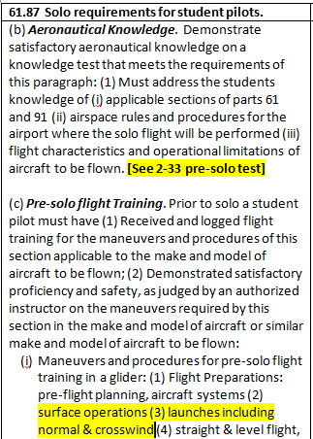
Discussion
Importance of giving Instruction in good launch procedures to avoid incidents;
Ground and air signals;
Is the Rudder Waggle a safe signal?
Abort procedures;
Wing-runner safety;

Slide 14
Launch Signals

Slide 15
And Now for the rest of the story on the incident…
And it is a very important lesson for everyone to take away.
After the early termination, the glider pilot got out of the aircraft and immediately checked on the condition of the glider, and then the wing runner (joking – I'm sure it was the other way around . . .maybe . . .)
then they repositioned the glider for relaunch as the tug came back around in the pattern. I'm sure there was some vigorous arm-waving from inside the tug, and then relaunch.
At about 200 feet the pilot noticed the canopy creeping open, and realized that in all of the excitement of the proceeding event, he hadn't thoroughly gone through the checklist.
This is exactly what happens when things go wrong, and is part of the chain of events we talk about preceding an accident. In this case the pilot handled the event with no more drama, the tow was completed and the canopy re-latched and he went on the a long (and boring) flight.

