Slide 1
2020 Soaring Accident Review
Dr. Gerald A Smith, DMD,CFIG
NESA Spring Safety Meeting
April 3, 2021

Slide 2
Caveats:

Slide 3
What is an Accident vs Incident?
Aircraft accident means an occurrence associated with the operation of an aircraft which takes place between the time any person boards the aircraft with the intention of flight and all such persons have disembarked, and in which any person suffers death or serious injury, or in which the aircraft receives substantial damage.
Incident means an occurrence other than an accident, associated with the operation of an aircraft, which affects or could affect the safety of operations.
Reported to NTSB, not FAA

Slide 4
49 CFR PART 830—NOTIFICATION AND REPORTING OF AIRCRAFT ACCIDENTS OR INCIDENTS AND OVERDUE AIRCRAFT, AND PRESERVATION OF AIRCRAFT WRECKAGE, MAIL, CARGO, AND RECORDS
§ 830.1 Applicability.
§ 830.2 Definitions.
Subpart B—Initial Notification of Aircraft Accidents, Incidents, and Overdue Aircraft
§ 830.5 Immediate notification.
§ 830.6 Information to be given in notification.
Subpart C—Preservation of Aircraft Wreckage, Mail, Cargo, and Records
§ 830.10 Preservation of aircraft wreckage, mail, cargo, and records.
Subpart D—Reporting of Aircraft Accidents, Incidents, and Overdue Aircraft
§ 830.15 Reports and statements to be filed.

Slide 5
In 2020 17 total glider accidents reported to the NTSB
5 - Fatalities
5 - Serious Injuries
2 - Minor
5 - NONE!

Slide 6
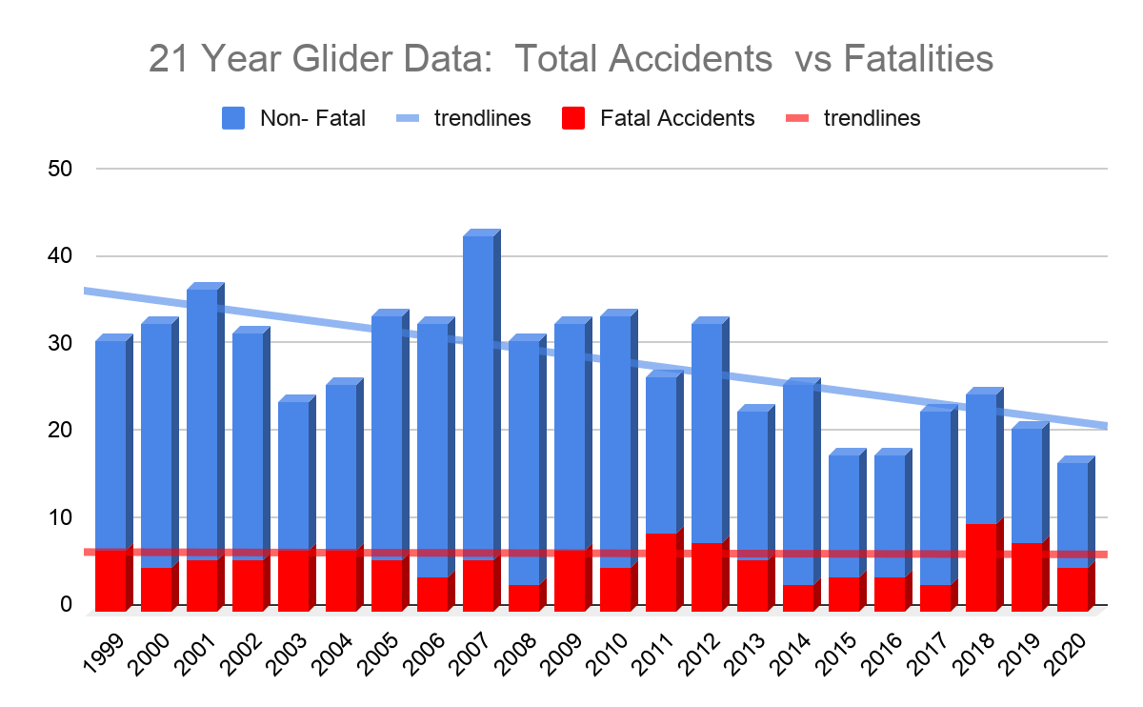

Slide 7
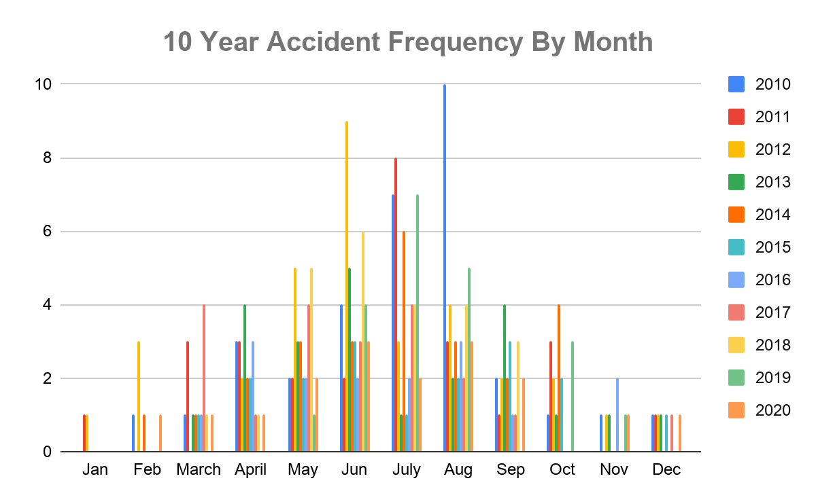

Slide 9
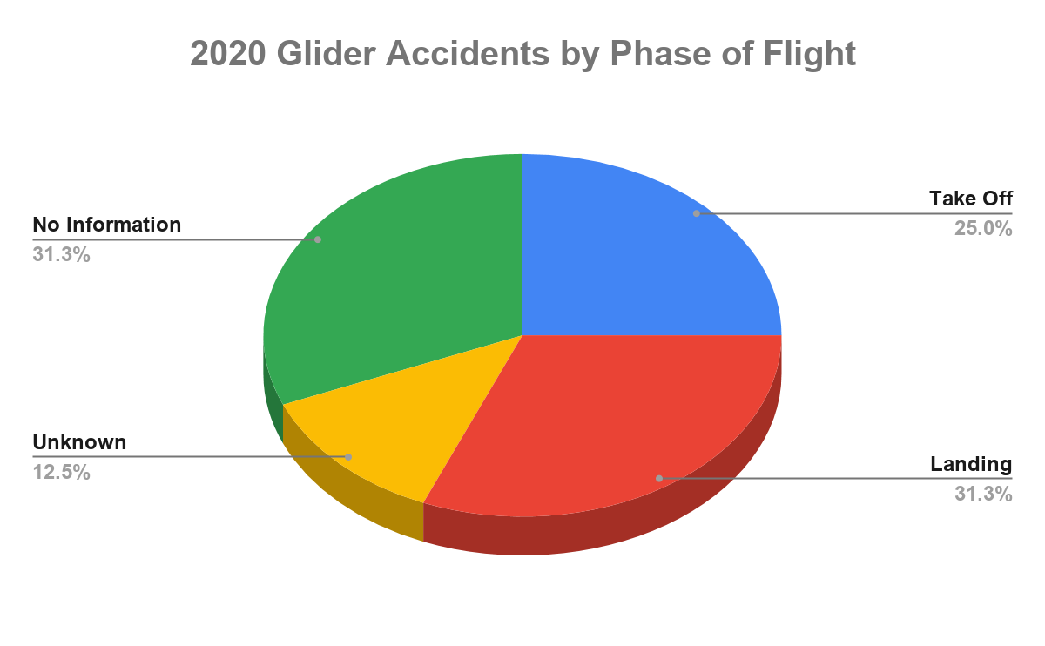

Slide 10
Phase of Flight
Take off
“Rope Break” instruction flight: stall/spin (2-S)
Out of position on tow, low release: Stall/spin (F)
High wind takeoff, wing tip struck ground, leveled, sharp pull up stall/spin (MG) (F)
Spoilers Deployed on Takeoff, ran off runway end (MG) (S)
Landing
Slow on downwind, stall spin (F)
“Lost ground speed”, rapid descent off airport (N)
Off field landing, ground loop (M)
Off field landing (private strip) unmowed; hit fence (N)
Off airport 2-33 (N) (wind 18G27)

Slide 11
Phase of Flight
Unknown
Wreckage found on mountain (F)
Wreckage found in woods. (F)
No Details
Grob 102 (M)
PIK/2-33 (M)
ASK 21
ASW20C/ASW 27 (2- S)
Club Libelle

Slide 12
Deeper Dive on one...
Pilot: 79
ASEL, Glider
770 hours total time
Built the Pipistrel Sinus in 2019
Estimated 20-22 hours in type
6 hours dual in Switzerland in 2018
3 hours dual in FL in 2018
3 hours dual in FL in 2020
In May 2020 he had flown this aircraft 10 hours and made 55 landings as part of flight testing regimen

Slide 13
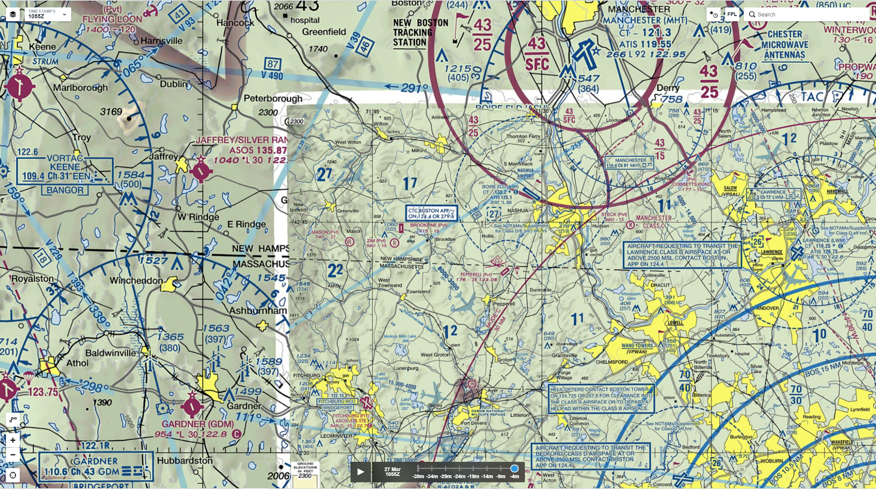

Slide 14
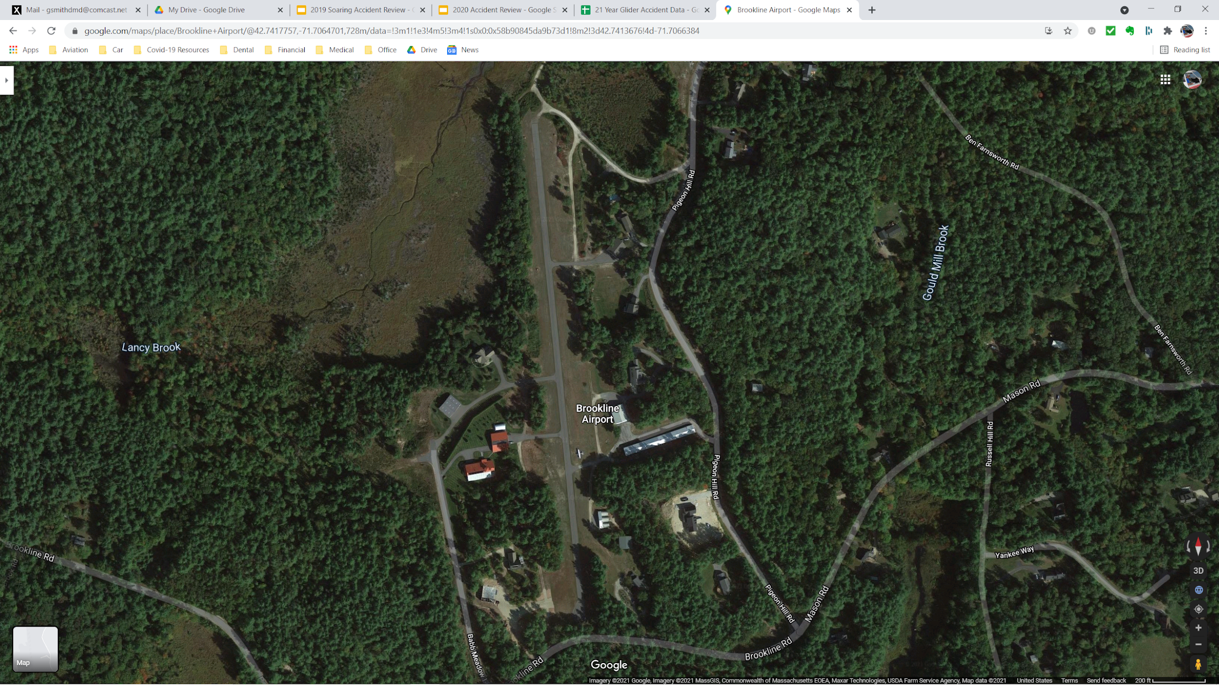

Slide 15
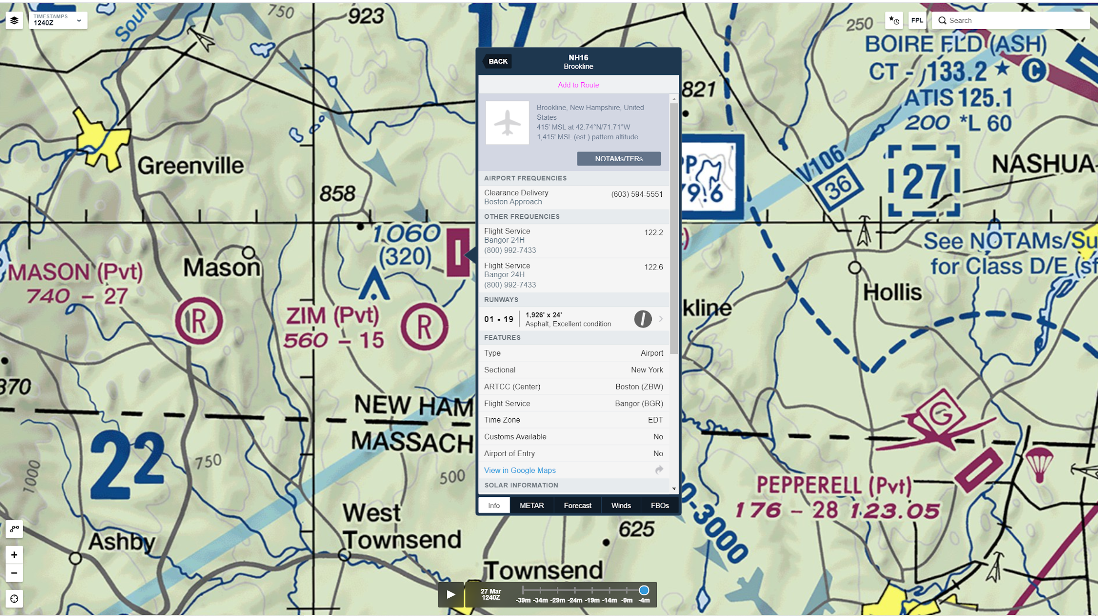

Slide 16
What Happened? (source: NTSB Final Report)
Analysis The pilot of the experimental, amateur-built motor glider was landing on a 1,926-ft-long, 24-ft wide runway with about a 6 knot quartering tailwind. During his first attempted landing the motor glider was high and fast on approach and the pilot elected to go-around. During his second attempt, the motor glider was also high and fast but the pilot elected to continue the approach to landing, using full air brakes and wing flaps. During the approach, he slowed the motor glider to 40 knots (6 knots above stall speed), and the motor glider then seemed to drop from about 10 ft above the runway and land hard. The right landing gear leg collapsed, and the motor glider veered off the right side of the runway, struck a vertical approach slope indicator, and was substantially damaged. Review of the Pilot's Operating Handbook revealed that the final approach speed should always be 55 knots with full flaps regardless of approaching with zero or full air brakes. The pilot reported that there were no pre-impact mechanical malfunctions or failures with the motor glider that would have precluded normal operation. Probable Cause and Findings The National Transportation Safety Board determines the probable cause(s) of this accident to be: The pilot's failure to maintain airspeed while landing with a quartering tailwind, which resulted in a loss of control and a hard landing.

Slide 17
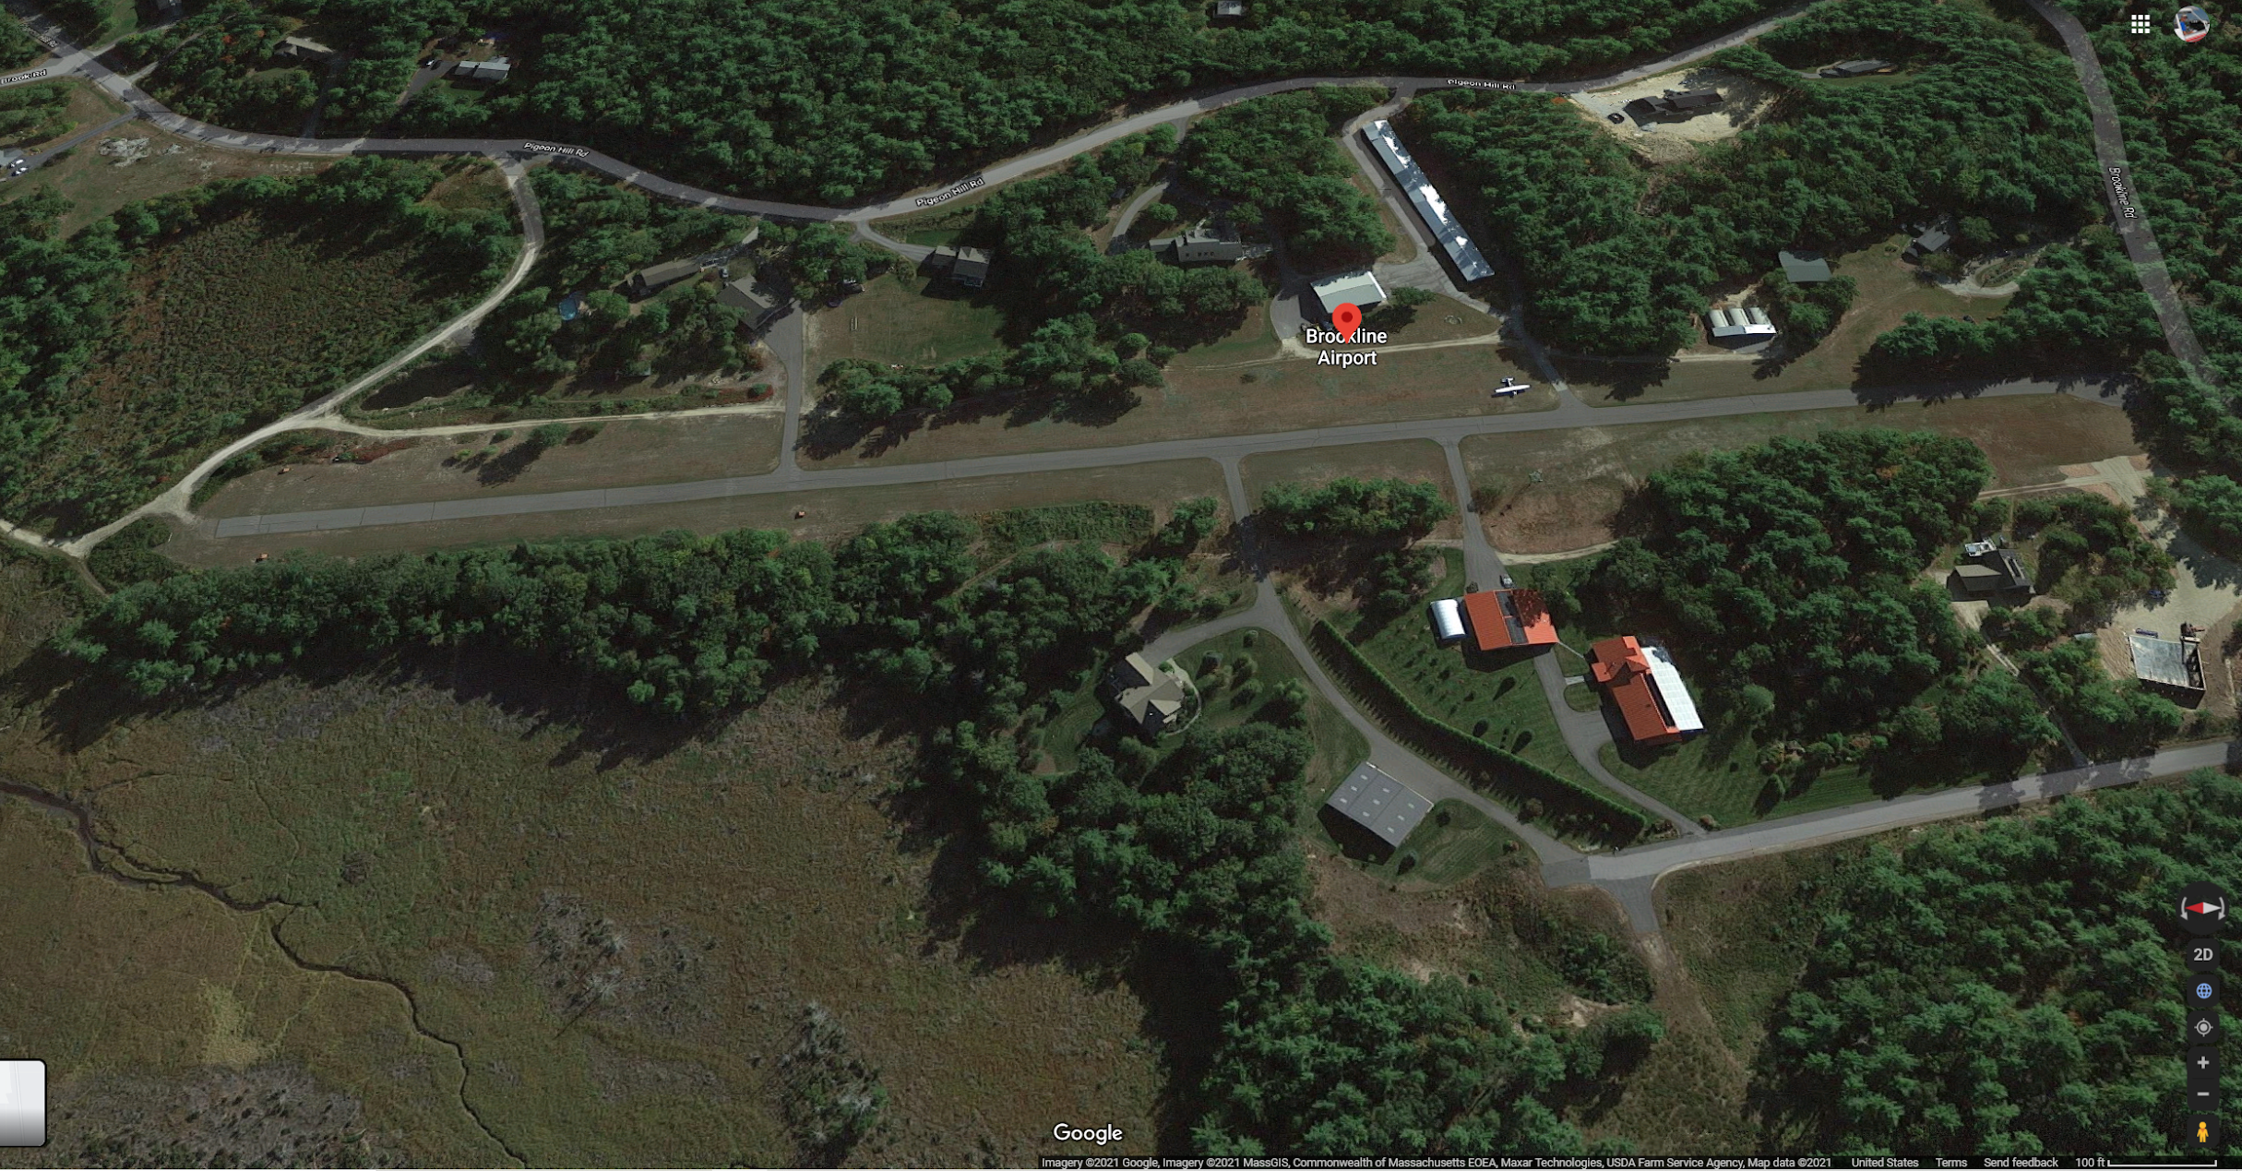

Slide 19
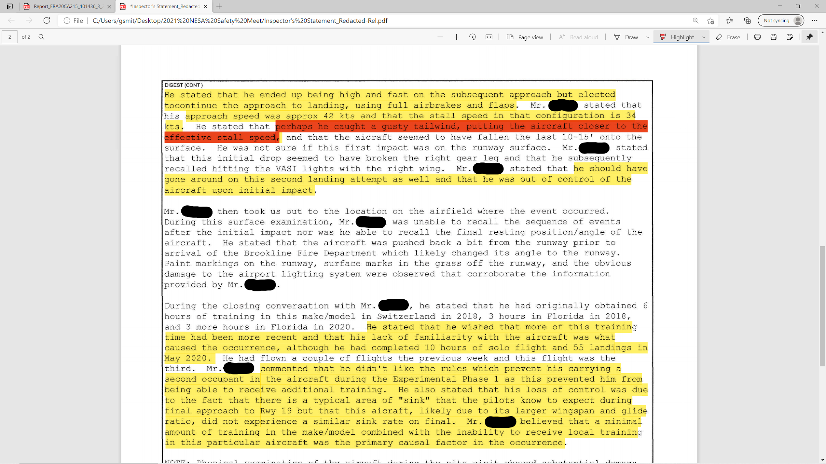

Slide 20
Lessons for us
Landing with a tailwind:
Does it change aerodynamics?
It will increase our ground speed and subsequent landing distance
For every 2 knots it adds about 10% to the landing distance in this case about 30%

Slide 21
Lessons for us
Fly a stabilized approach.
Have an aim spot and adjust your glideslope to that.

Slide 22
Should you be involved in an “event”...
Emergency care/safety
Review the NTSB requirements
File “NASA” Report
Contact a flight instructor or a FAASTeam Rep to discuss the event
Get dual instruction with an instructor

Slide 23
Before you fly
Think...

