Slide 1
Getting Your Head Back Into The Game
Dr. Gerald A Smith, DMD, CFIG
NESA 2021 Spring Safety Meeting
April 3, 2021

Slide 2
It’s just like riding a bike...

Slide 3
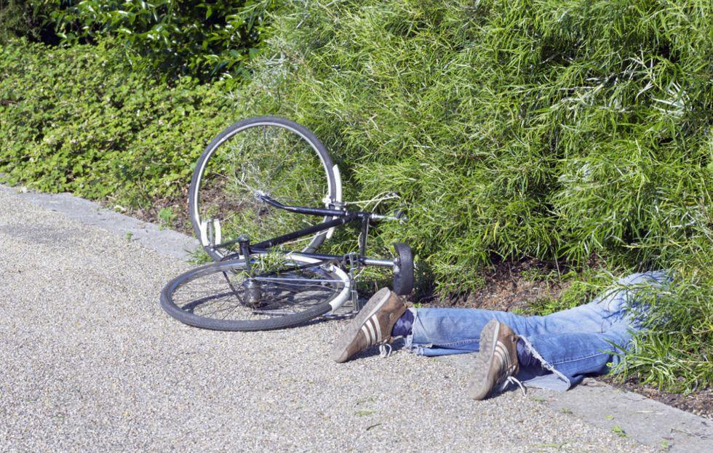
This is bike riding too...

Slide 4
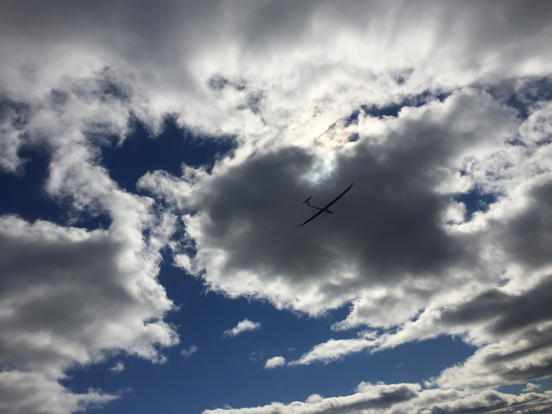

Slide 6
So how can we SAFELY get back...

Slide 7
Review your logbook

Slide 8
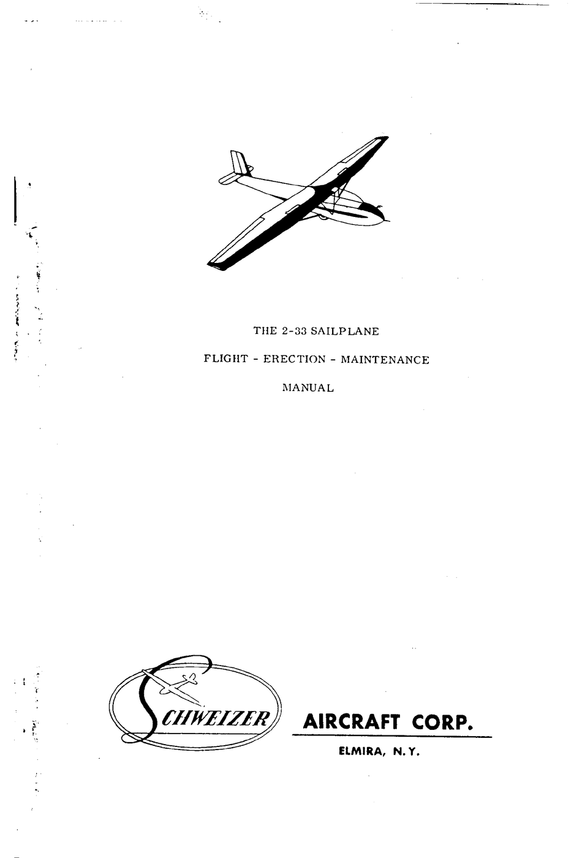
Review your Flight Manual

Slide 9
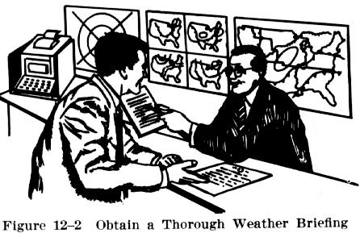
Get a preflight briefing

Slide 10
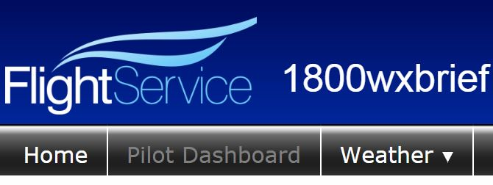
https://www.1800wxbrief.com/Website/login#!/

Slide 11
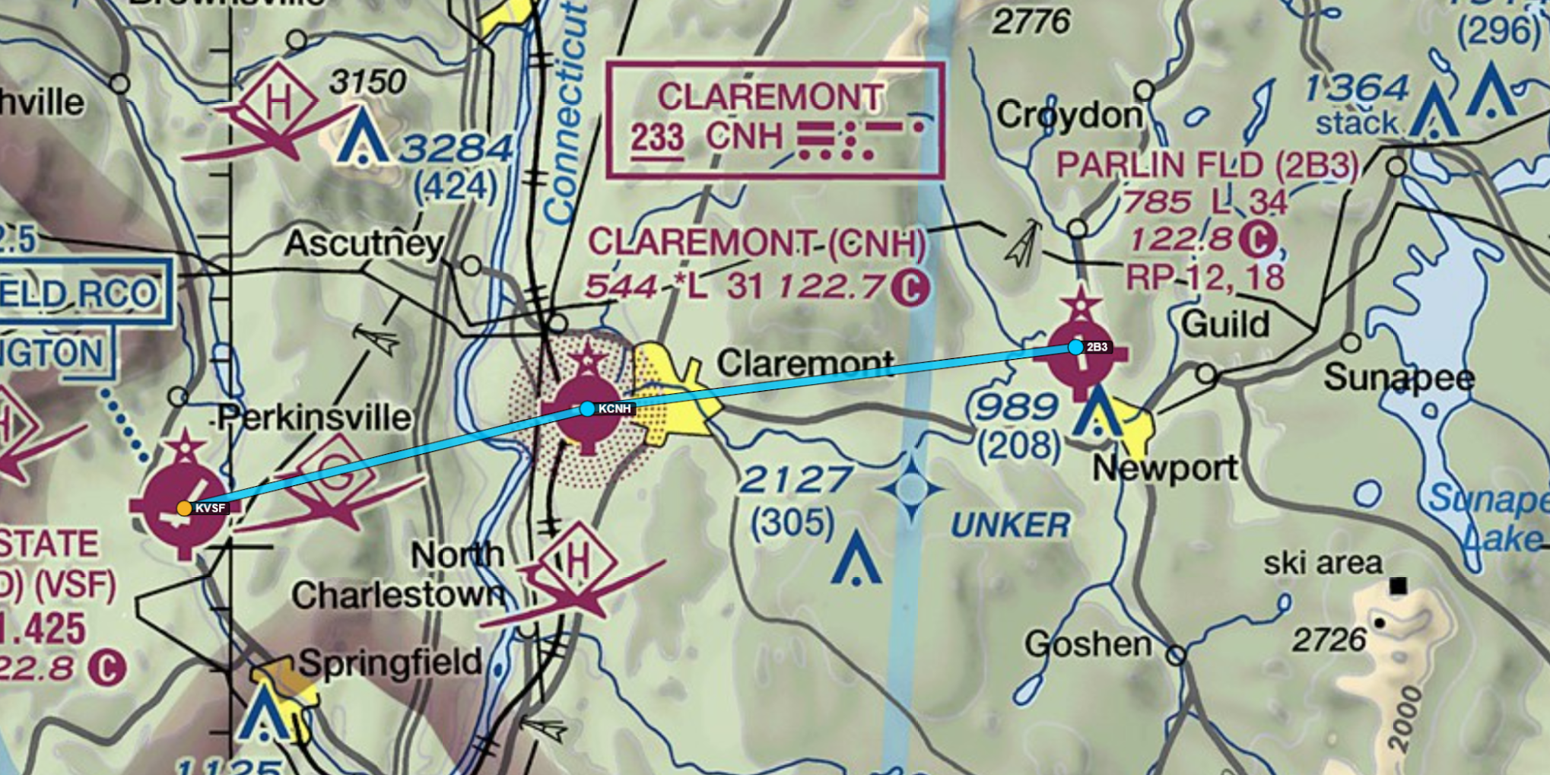
Plan a cross-country flight

Slide 12
Read texts/watch videos/take on-line courses
www.faa.gov
https://www.youtube.com/results?search_query=glider+flying+lessons
https://academy.gliderbooks.com/collections

Slide 13
Review NTSB reports for the aircraft you fly most often
https://www.ntsb.gov/_layouts/ntsb.aviation/index.aspx

Slide 14
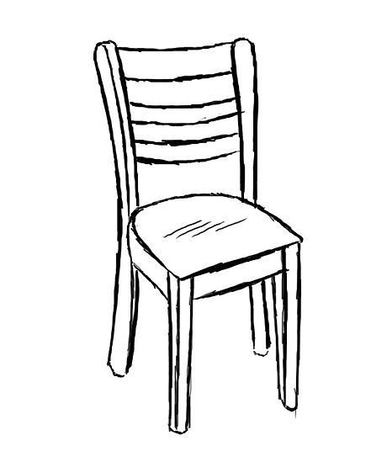
Chair Fly

Slide 15
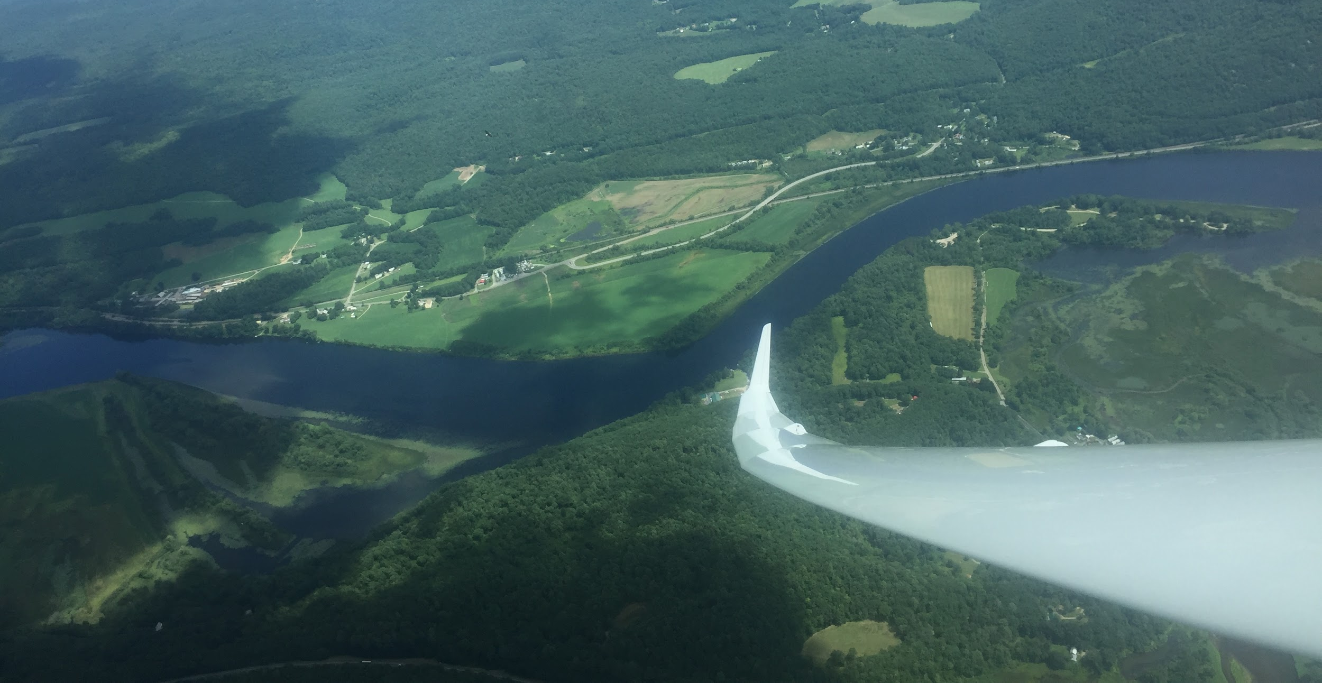
Fly with an instructor

Slide 16
Have a great season!

