Slide 1
Setting Goals for safer (and more rewarding) Flying
New England Soaring Association Safety Meeting 2021
Brian Xander, CFIG
Chris Giacomo, CFIG

Slide 2
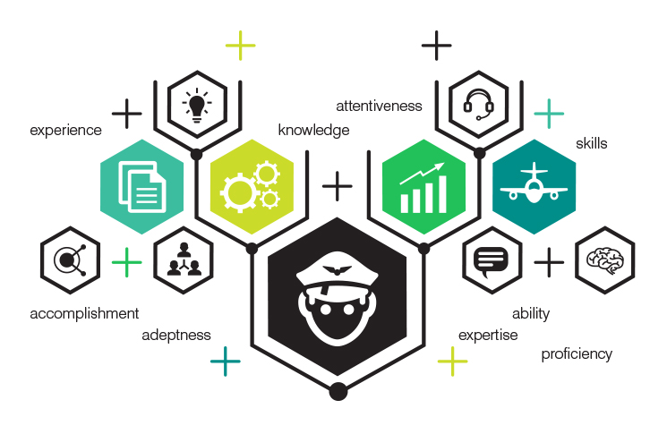
A Pilot’s Four Levels of Competency
From Thomas Turner, Master CFI based on a
Theory by Capt. Alan Gorthy, Jr. USN ret.

Slide 3
LEVEL 1 - I DON’T KNOW WHAT I DON’T KNOW
This is the pilot who knows ‘just enough to be dangerous’. They meet minimum standards for pilot certification and ratings, but these pilots have not actively worked to go beyond the bare minimums, or to grow within the practice of flight—a profession we all practice, regardless of whether we are paid to fly.

Slide 4
LEVEL 2 - I KNOW WHAT I DON’T KNOW
These pilots know there are limits to their knowledge and capability, and at least should be actively working to fill the gaps and expand within the practice of flight. These pilots will set conservative personal limitations and (hopefully) have the discipline to fly within those limitations regardless of temptations and pressures.

Slide 5
LEVEL 3- I KNOW WHAT I KNOW
These pilots have filled many of the knowledge and skill gaps, and worked to retain skills—they are confident that they could pass today if given a no-notice checkride for the certificates and ratings they hold. Level 3 pilots will adhere to personal limitations—by knowing what they know, the Level 3 pilots are more capable of intelligently creating personal limitations. These pilots actively seek new and challenging training opportunities and read voraciously on the topic of being a better pilot.

Slide 6
LEVEL 4 - I’M A NATURAL
These pilots are at the top of their game, and are ready for anything the aircraft, the environment or the operation can throw at them. Being ‘in the zone’ as a pilot is a matter of currency, recency and practice—in normal, abnormal and emergency procedures—as much as it is knowledge and past experience.

Slide 7
Which Type are you?
Your proficiency depends on your operation, glider, objectives, and mindset EVERY TIME YOU FLY
Most “great” pilots will float between 3 and 4, and are constantly working to be in the “4-zone”
This is achieved though setting skill-based GOALS that iterate as a pilots develops

Slide 8
Setting SMART Soaring Goals
SPECIFIC – Well Defined and to the point
MEASURABLE – Quantifiable end states are key!
ACHIEVABLE – Realistic, yet Challenging – be proud
RELEVANT – Use your goals to achieve your ambitions
TIME-BASED – Establish Urgency for planning

Slide 9
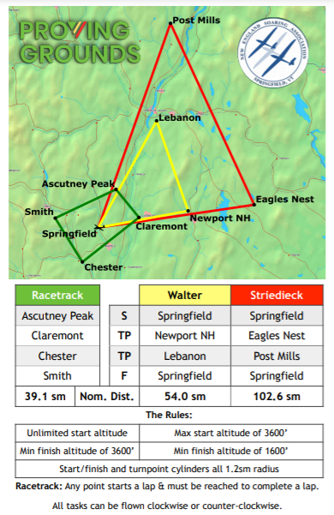
EXAMPLE – PROVING GROUNDS!
SMART GOAL: To complete the “Walter” Task in the club 1-34 by Labor Day
…and now what?

Slide 10
…Now We Start Questioning
How Current/Proficient are you?
How far have you previously flown X-C?
How Familiar are you with the 1-34?
How Familiar are you with the Area?
Have you flown through Class D Airspace Before?
…And build a plan to fill the gaps!
Share your goals and plans with a Mentor/CFI
Identify your concern areas and plan to mitigate them
Fly the route in google maps and/or Condor
Build a schedule of milestones to meet your goals
Tell people your goals to support/encourage you

Slide 11
Questions?
Reference Plan for a soaring goal – “A Greenhorn in the White Mountains” - http://files.leagueathletics.com/Text/Documents/3995/42621.pdf

