Slide 1
Spring Reminders: - Currency vs. Proficiency - ADM & Risk Management
Alasdair Crawford, CFIG
NESA

Slide 2
Current vs. Proficient
We are all looking forward to the upcoming season;
Spring often offers some fantastic soaring and “strong” conditions;
Are we ready?
Our ships have been tucked away for the winter and equally, so have we…
Many of us flew very little or not at all last year due as a result of COVID;
Most of us will begin this season Rusty.

Slide 3
Current vs. Proficient
In 1901 Wilbur Wright stated that “practice is the key to the secret of flying”;
Ever since we have recognized the importance of maintaining proficiency;
The FAR’s provide some regulatory guidance on the required “minimum” practice, i.e. currency;
Our club rules provide additional guidance with respect to minimums for the use of club equipment;

Slide 4
Current vs. Proficient
Human factors tell us that retaining previously acquired skills is dependent upon several factors
The “Law of Exercise” (most repeated/best remembered);
The “Law of Recency” (things recently performed are more readily remembered);
These factors are the drivers behind why the FAR’s include the “currency”/recency of experience requirements they do.
Our winter (and now COVID-19) time-out means many all of us are lacking in that recent exercise of glider flying skills required for retention.

Slide 5
Current vs. Proficient
Before you fly club ships we require a spring check flight;
Before you fly your own ship solo you need, well technically only a current flight review within 24 months;
Before you carry passengers you need “Current” recency of experience, i.e. 3 take-off’s and landings within 90 days;
If you are a previously soloed student your solo endorsement most likely will have expired and you will need to fly with an instructor and obtain a new one;
If you are a transition pilot holding a certificate for another category of aircraft but are student glider pilot you need a current flight review in a category for which you are rated. (If not actively flying the other category the Wings program is usually the best way to achieve this);

Slide 6
Current vs. Proficient
These FAR and club “Currency” requirements may make you legal to launch off into the gusty conditions of the first strong soaring day, but are they sufficient to make us “Proficient” to do so safely?
Perhaps, perhaps not. We all have different experience; some of us actually flew during the winter; some of us have many hours, some of us just got our licenses in the fall then immediately hung up our wings for the winter;

Slide 7
Current and Proficient
Remember that by definition
“Proficiency” means performing a skill with “expert correctness”;
Currency only indicates being up to date or occurring within a recent period of time.
We need to be both current and proficient to fly safely in challenging conditions such as strong spring soaring conditions;

Slide 8
Current and Proficient
So, lets all exercise good ADM this spring and season, manage our Risk and not “make Junk”.
Are you “Proficient” for the flight you plan to undertake, consider your currency and experience, the aircraft you are about to fly and the conditions of the day.
In other words…think P.A.V.E. and manage your risk.
If it’s your first day out and conditions are breezy or gusty, ask yourself if it really is the day for your first flight of the season. Exercise good ADM.
If you’re rusty, take a couple of extra flights with an instructor.
Factor your Rustiness into your early season personal minimums.
Set your Personal Minimums for early season conservatively.
You can revise these later in the season (but never do so on the day);

Slide 9
It’s about Risk Management
Currency & proficiency considerations are just one part of managing risk;
We can’t eliminate all risk from our sport, but we can manage it;
P – Pilot
A – Aircraft
V – enVironment
E – external pressures

Slide 10
It’s about Risk Management
We can’t eliminate all risk from our sport, but we can manage it;
P – Pilot
I – Illness
M – Medication
S – Stress (problems?, personal?, job?, family?)
A – Alcohol – Booze in last 8,12,24 hours?
F – Fatigue – How tired are you?
E – Eating Energy levels?
R – Recency of experience/Rustiness.
A – Aircraft
V – enVironment
E – external pressures

Slide 11
It’s about Risk Management
We can’t eliminate all risk from our sport, but we can manage it;
P – Pilot
A – Aircraft
Performance limitations
Equipment
E.g. familiarity, suitability, understanding, ELT/PLB tests/registrations, 180 day Parachute repack, Transponder, current airspace & turn-point databases etc.
Airworthiness
Suitability for the mission
Familiarity/experience in type (New glider to you?)
V – enVironment
E – external pressures

Slide 12
It’s about Risk Management
We can’t eliminate all risk from our sport, but we can manage it;
P – Pilot
A – Aircraft
V – enVironment
Weather
Terrain
Airspace (challenges for flight/understanding of rules)
e.g. Class D, MOA’s etc., TMOA (Chugs)
Airport
E – external pressures

Slide 13
It’s about Risk Management
We can’t eliminate all risk from our sport, but we can manage it;
P – Pilot
A – Aircraft
V – enVironment
E – external pressures
Later commitments with family and friends
Desire or peer pressure to complete the task
It’s always worked out in the past/no place to land
Need to get the flight in before weather arrives
Badges, OLC points etc.

Slide 14
It’s about Risk Management
Summary
P – Pilot
A – Aircraft
V – enVironment
E – external pressures

Slide 15
Scenarios

Slide 16
Scenarios

Slide 17
Scenarios

Slide 18
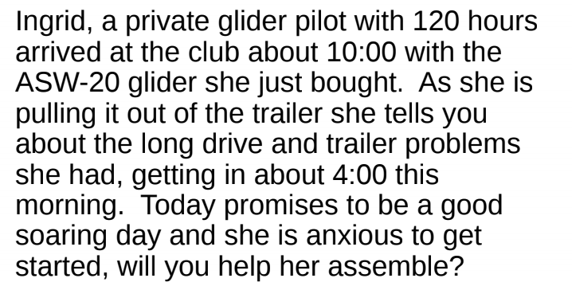
Scenarios

Slide 19
PAVE Analysis and Mitigation

Slide 20
Summary
Most of us have not flown or not flown gliders in a while;
Make sure you have the regulatory and club requirements met;
Currency requirements are a legal minimum only. They do not guarantee we are safe or safe for the particular upcoming flight/mission;
The Club rules require you to take a spring check-flight with an instructor before flying club equipment;
In the past the club recommended you take a Spring check-flight even if you fly your own ship. Now that NESA is the tow provider it is mandatory.
Exercise good ADM with respect to Risk Management.
Most soaring accidents are a result of judgment/decision failure not aircraft failure;
Think through the P.A.V.E. factors and confirm that you are safe to fly your planned mission given todays conditions;
Set conservative early season personal minimums and adhere to them;
If you have any doubts talk to one of the club instructors and/or consider taking a flight with them;
Have a safe and fun flying season!

Slide 21
Q&A and Survey
Quick Survey
Please open the CHAT window. There is a link survey link (https://survs.com/survey/x1hsawyqz4).
We would like club members to complete the survey (4 questions) to help us understand everyone's currency and immediate needs - flight reviews, Rusty pilot reviews etc. so that we can get everyone’s needs on scheduled and addressed and get you back to flying;
Q&A
Meeting will now be placed in a brief Q&A session.

Slide 22
Lets have a safe & fun Season
NESA CFIG’s
Jerry Smith
Dave Carton
Alasdair Crawford
Bill Batesole
Brian Xander
Chris Giacomo
Charlie Freeman
Daryl Smith
Will Dismukes
Mark Farley
Steve Brown

