Slide 1
NESA Spring Safety Webinar 2021

Slide 2
Safety Seminar Agenda
Introduction & Welcome (Larry Perry)
Getting your head back in the game after COVID layoff
Review of lessons from 2020 glider accidents (Jerry)
Setting you personal goals for 2021 (Chris/Brian)
Currency, Proficiency (Alasdair)
Website Tools: scheduling, W&B,SMS, Squawks (Mark)
COVID Rules & procedures
Open Discussion Forum;

Slide 3
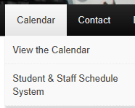
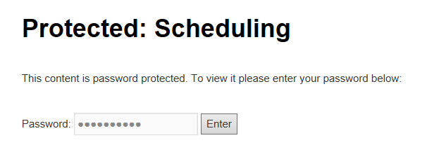
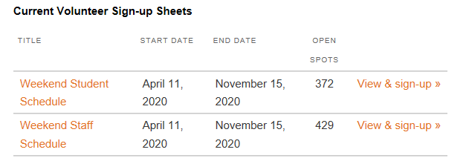
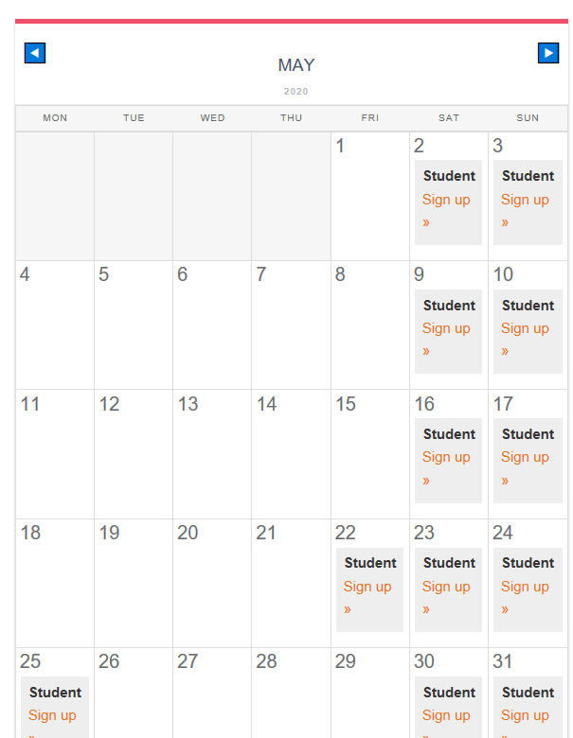
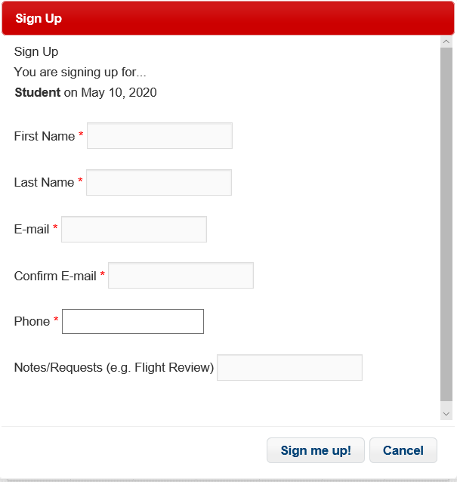
Website Tools: Scheduling
N1242S

Slide 4
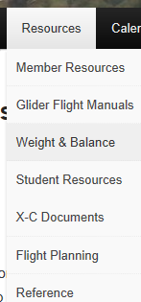
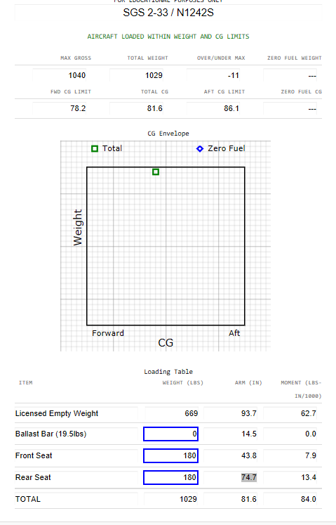
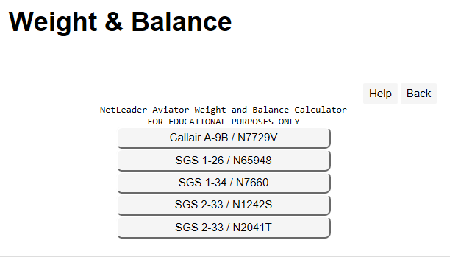
Website Tools:W&B Calculators

Slide 5
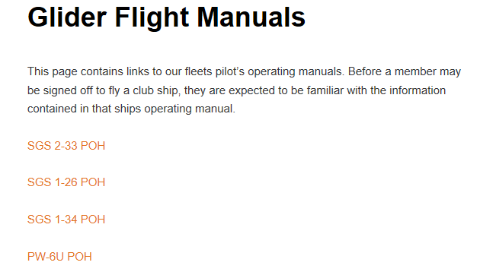
Website Tools: POH’s

