Slide 1

2025 Glider Accident Review
NESA Spring Safety Meeting
April 4, 2026
Dr. Gerald A Smith, DMD, CFIG

Slide 2
A few words about intent and methodology…

Slide 3
Primary Sources are NTSB database

Slide 4
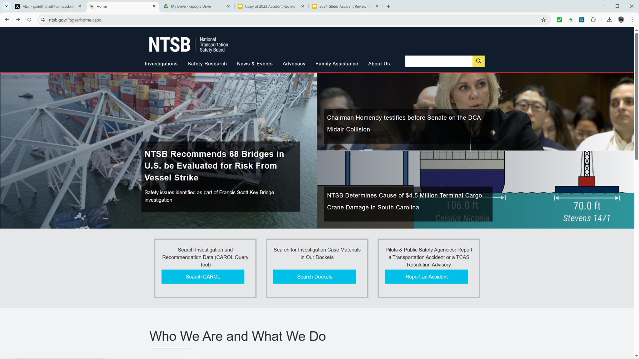

Slide 5
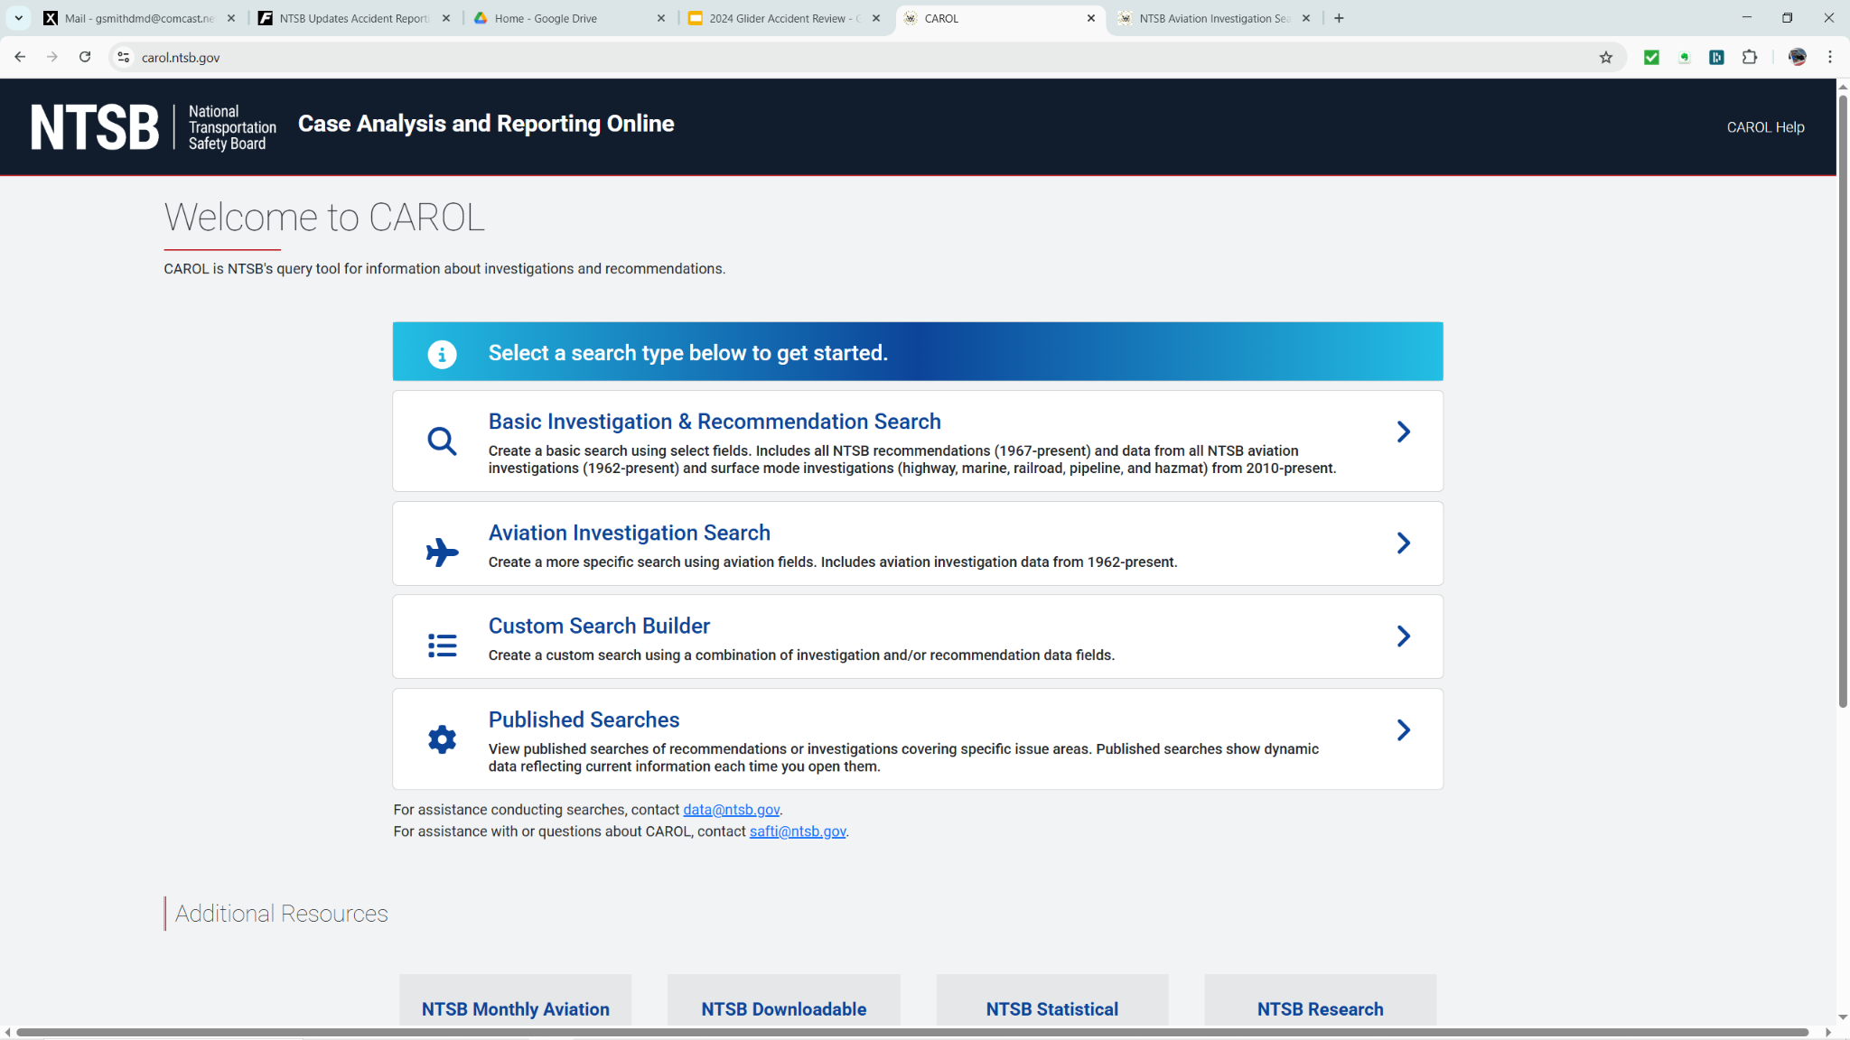

Slide 6
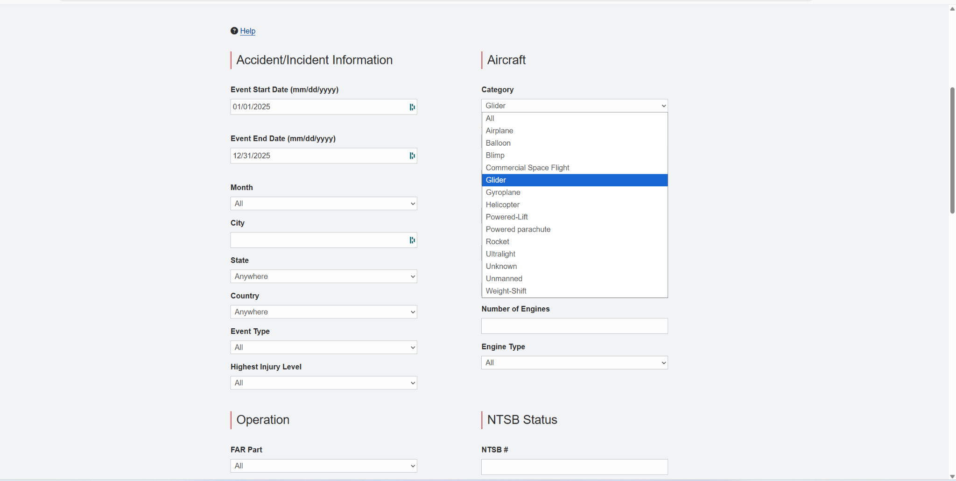

Slide 7
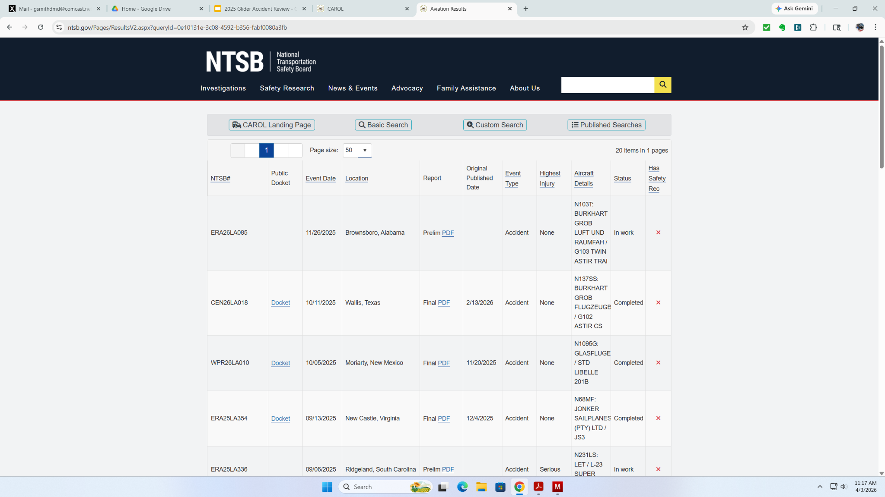

Slide 8
What is an Accident vs Incident?
Aircraft accident means an occurrence associated with the operation of an aircraft which takes place between the time any person boards the aircraft with the intention of flight and all such persons have disembarked, and in which any person suffers death or serious injury, or in which the aircraft receives substantial damage.
Incident means an occurrence other than an accident, associated with the operation of an aircraft, which affects or could affect the safety of operations.
Reported to NTSB, not FAA

Slide 9
49 CFR PART 830—NOTIFICATION AND REPORTING OF AIRCRAFT ACCIDENTS OR INCIDENTS AND OVERDUE AIRCRAFT, AND PRESERVATION OF AIRCRAFT WRECKAGE, MAIL, CARGO, AND RECORDS
§ 830.1 Applicability.
§ 830.2 Definitions.
Subpart B—Initial Notification of Aircraft Accidents, Incidents, and Overdue Aircraft
§ 830.5 Immediate notification.
§ 830.6 Information to be given in notification.
Subpart C—Preservation of Aircraft Wreckage, Mail, Cargo, and Records
§ 830.10 Preservation of aircraft wreckage, mail, cargo, and records.
Subpart D—Reporting of Aircraft Accidents, Incidents, and Overdue Aircraft
§ 830.15 Reports and statements to be filed.

Slide 10
In 2025 20 total glider accidents reported to the NTSB
1 of which resulted in fatality

Slide 11
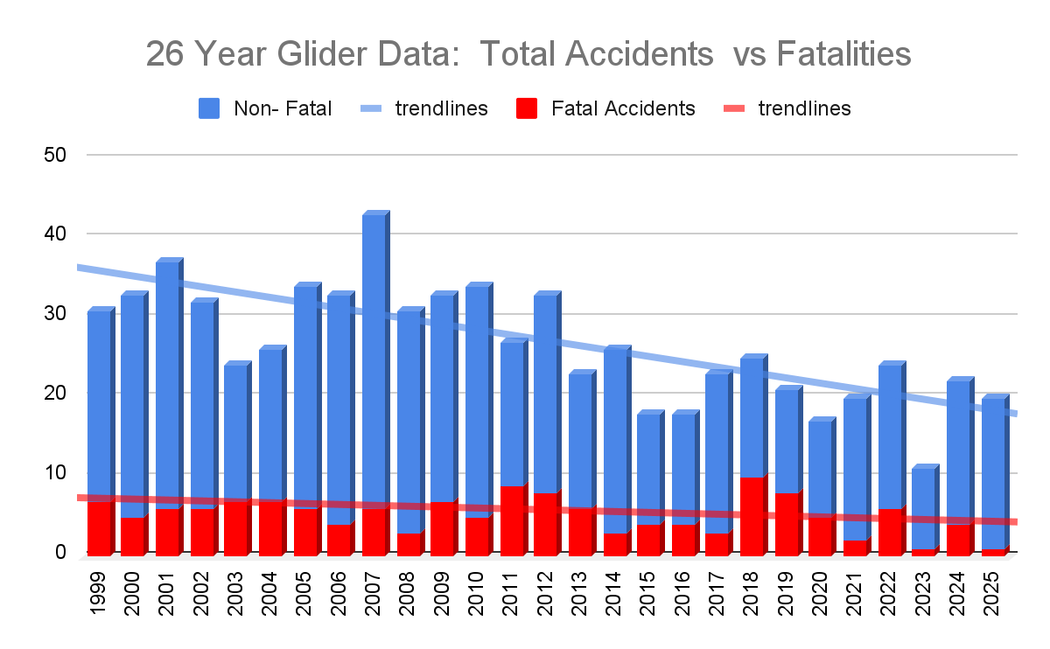

Slide 12
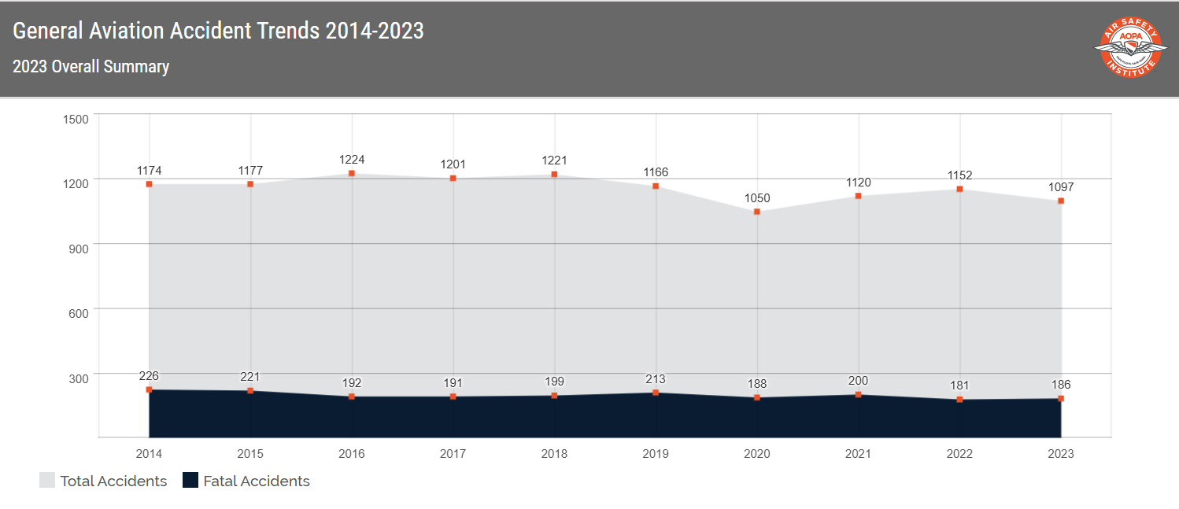

Slide 13
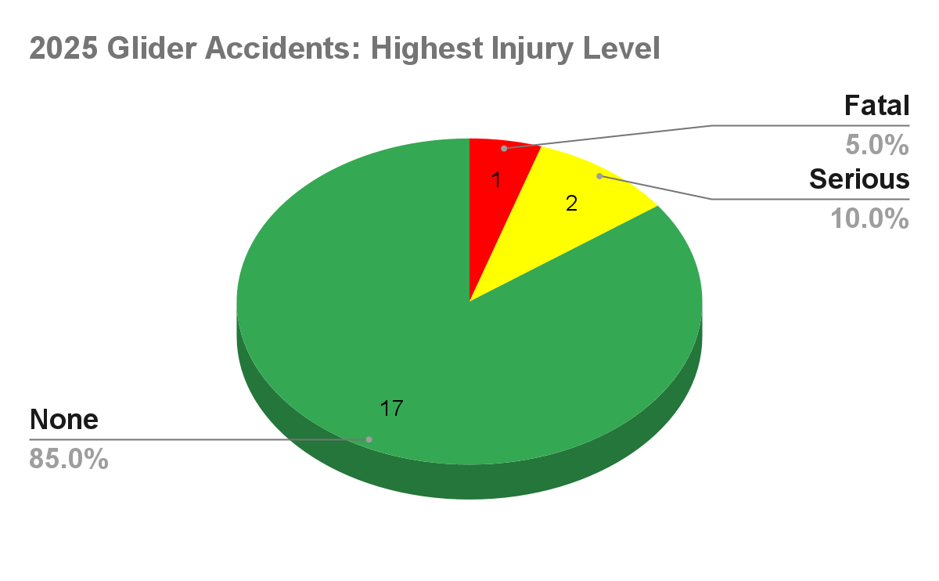

Slide 14
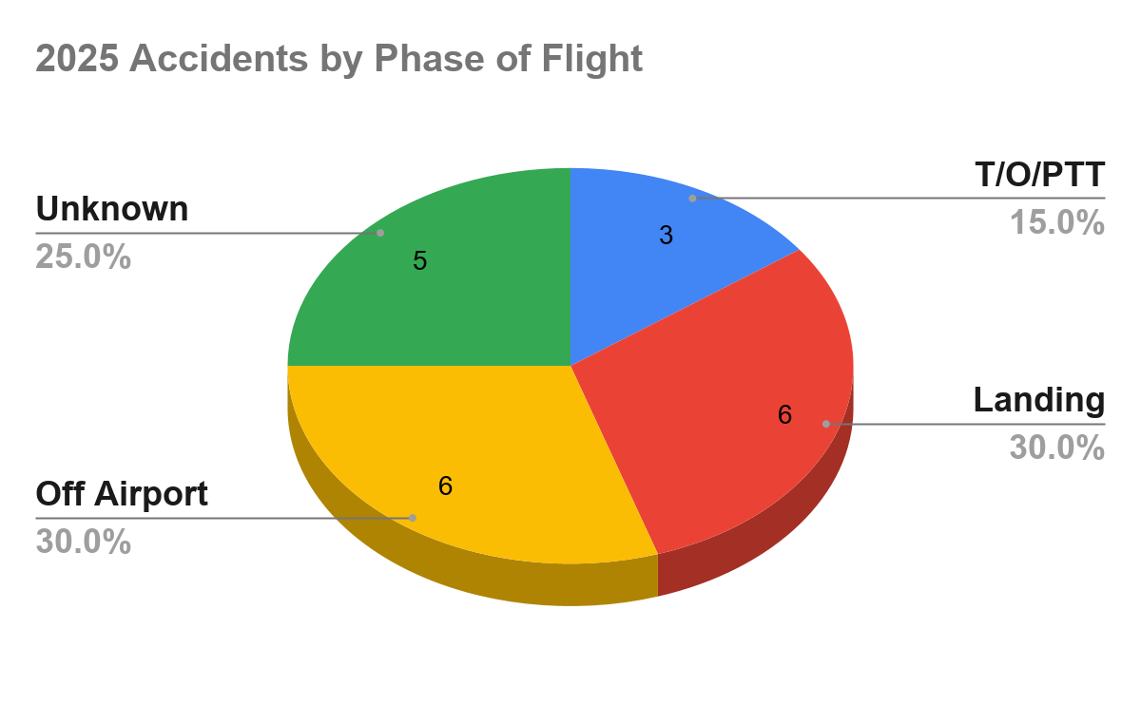

Slide 15
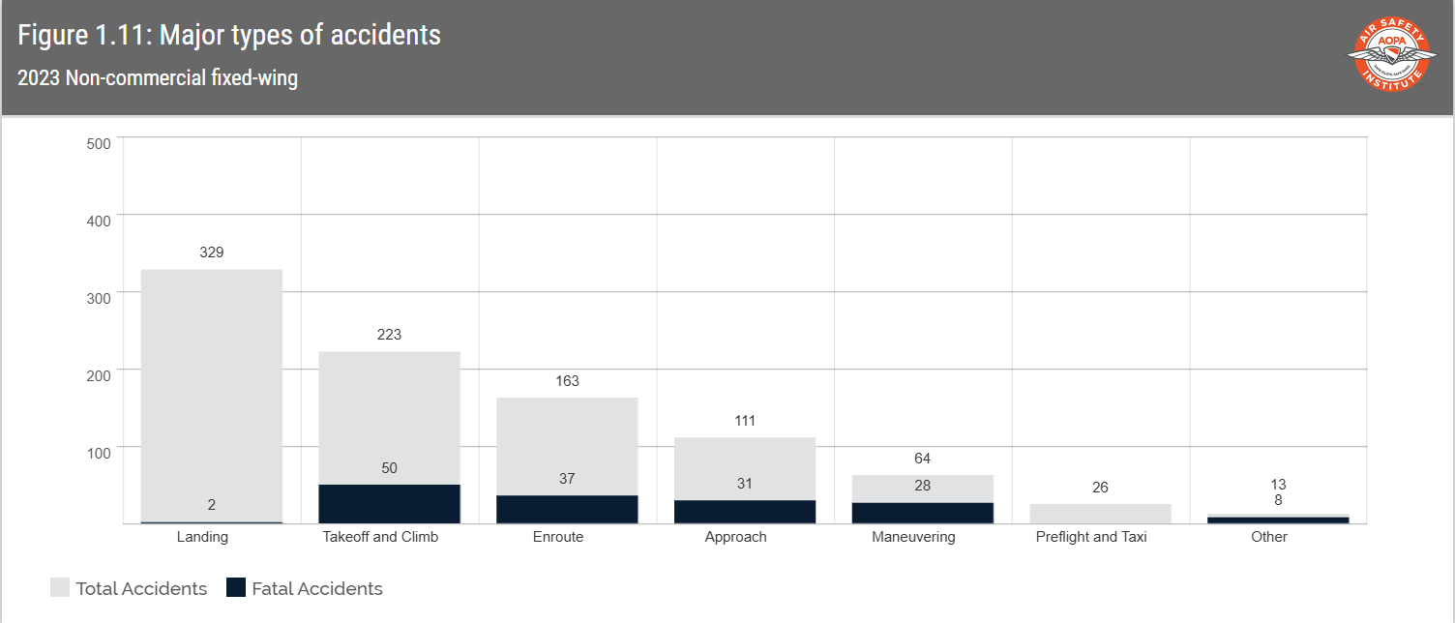

Slide 16
Weather
This year weather did not play a significant factor in any accident, although managing cross winds did play a role in some.
All of the accidents occured in what we’d consider good/reasonable soaring weather.

Slide 17
Phase of Flight: Landing

Slide 18
Phase of Flight: Landing/Off Airport
Often the reports begin with “encountered heavy sink”
Arrived at intended landing airport lower than expected
Or forced to use alternate landing surface

Slide 19
Phase of Flight: Landing
1.SGS 2-33: Instructor with student in windy conditions (12G20) talking thru landing went too far downwind, landed short
2. SGS 1-26C: Initially high, got too low changed runways overshoot *
3. Grob 103: Student Hard landing
4.SGS 2-33: Student misread altimeter got too low impact ground Base-Final

Slide 20
Phase of Flight: Landing
5. JS 3: Return to Airport after soaring flight decided to test run jet; ran for 45 seconds forgot to stow engine after shut down. Had a high sink rate recited normal checklist, deployed gear and flaps, sink increased decided to retract flaps and inadvertently put in a negative flap went in trees before turning final.
6. Grob 102: Intentionally landed long to put away glider, allowed energy to dissipate in ground effect to stretch glide, dropped left wing and ground looped.

Slide 21
Phase of Flight: Landing SGS 1-26 Analysis
Private glider pilot returning to airport to land. He was south of the airport, and high, he encountered lift and got even higher. While still south of airport he deployed spoilers and initiated a slip.
Sky Soaring (55LL) 09/27 turf 3000 ft
Wind NW @ 10 no G

Slide 22
Sky Soaring
https://skyvector.com/
https://www.google.com/maps/@42.1517441,-88.5226058,3598m/data=!3m1!1e3?entry=ttu&g_ep=EgoyMDI2MDMzMC4wIKXMDSoASAFQAw%3D%3D

Slide 23
Phase of Flight: Landing - Off Airport
1. Stemme SF10: in cruise flight ran out of fuel, forced landing
2. ASW 19: towed downwind released 2500’ AGL about 3 miles from Apt. some lift but continued to drift downwind. Decided to return to airport but got too low, selected a field but a fence was across his path
3. LS7: X/C flight got low landed on a road dropped wing on shoulder berm and ground loop.
4. PW 5: X/C flight, got low landed on a closed runway struck a fence.

Slide 24
Phase of Flight: Landing - Off Airport
5. Grob 103: rough tow in rotor toward mountains; released and immediate heavy sink, turned toward apt; noted spoilers were open. Closed spoilers but too low with no lift. Selected a field and flew a pattern, wing tip caught in tall grass and ground loop
6. Libelle: got low landed in rough terrain and ground loop.

Slide 25
Take Away Thoughts
Are you arriving with enough reserve to land at the airport?
Careful evaluation of alternate landing sites
Awareness of obstacles?
Is your final touchdown speed proper?

Slide 26
Take Away Thoughts…
Hone your landing skills with an instructor.
Practice “alternative” patterns: right patterns, abbreviated patterns;
Practice minimum energy touchdowns and maximum performance stops.
Keep wings level

Slide 27
Phase of Flight: Take off/ PTT

Slide 28
Take Off/ Premature Termination of Tow
1. LS-6: Dropped wing, cartwheeled, released. No wingrunner, flaps in wrong position
2. Grob 102: Cross wind T/0: RW 36 wind 310@ 13 no gusts *
3. Pegasus: Take off without connecting elevator *

Slide 29
Take Off/ Premature Termination of Tow
Analysis Grob 102
Departing RW 36
Wind: 310 @ 13 No Gusts
(Grob 102 demonstrated x/w: 11 kts)

Slide 30
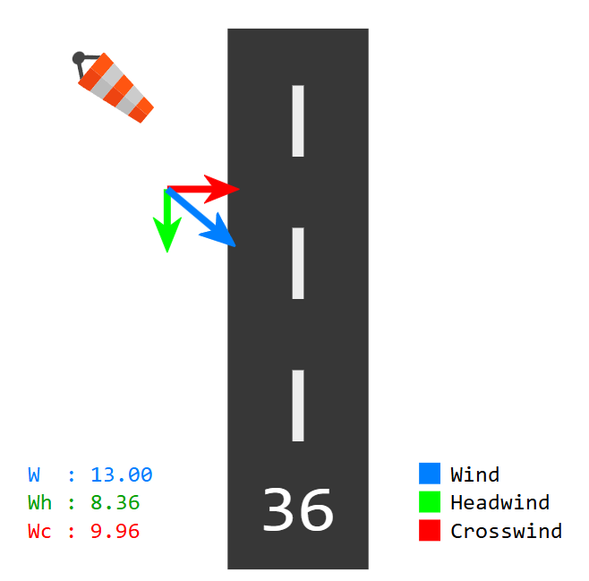
Take Off/ Premature Termination of Tow
Analysis

Slide 31
Take Off/ Premature Termination of Tow
Analysis Grob 102
“The tow began. I was deliberately mindful to keep the wings level given the serious crosswind. Soon I was veering left, west, out of a position behind the towplane, neither of us having left the ground. That angle increased. The left wing dropped to the ground and very soon a ground loop was in full effect. I released but did not brake. The right wing of the glider struck the railing along the bed of a golf cart as the glider came to a stop.”

Slide 32
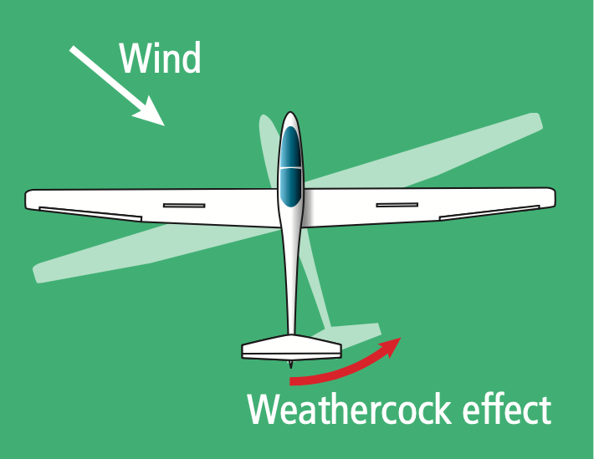

Slide 33
Mini Lesson/Review:
Crosswind Take-off Technique
Keep the upwind wing low (wing runner does this)
Full deflection of upwind aileron (once moving some will come out)
Full deflection of downwind rudder (once moving some will come out)
Be ready to release if things get too wonky

Slide 34
POP QUIZ
What is the max demonstrated x/w for SGS 2-33A?

Slide 35
Take Off/ Premature Termination of Tow
Pegasus Accident Synopsis
Came to the airport and assembled his glider with wing assistance from another member
Became distracted before connecting the elevator pushrod to elevator horn.
He returned from the distraction and “finished” rigging his glider
Used his vehicle and tow gear moved the glider to the flight line
Notes:
On its face this should never have happened.

Slide 36
Take Off/ Premature Termination of Tow
Pegasus Accident Synopsis
CB-SIT-CB mnemonic
Had to clear Runway for landing glider
CB-SIT-CB checked a 2nd time, wagged rudder and radioed “glider ready”
Notes:
On its face this should never have happened.

Slide 37
Take Off/ Premature Termination of Tow
Pegasus Accident: Pilot Narrative
“The tow was initially normal, but I quickly kited behind the towplane and found I had no pitch control. Aware of the danger to the tow plane in the rapidly developing situation, I pulled the release. Already nose high the sailplane stalled, pitched forward and fell to the ground landing in the turf to the right of the runway”
Notes:
On its face this should never have happened.

Slide 38
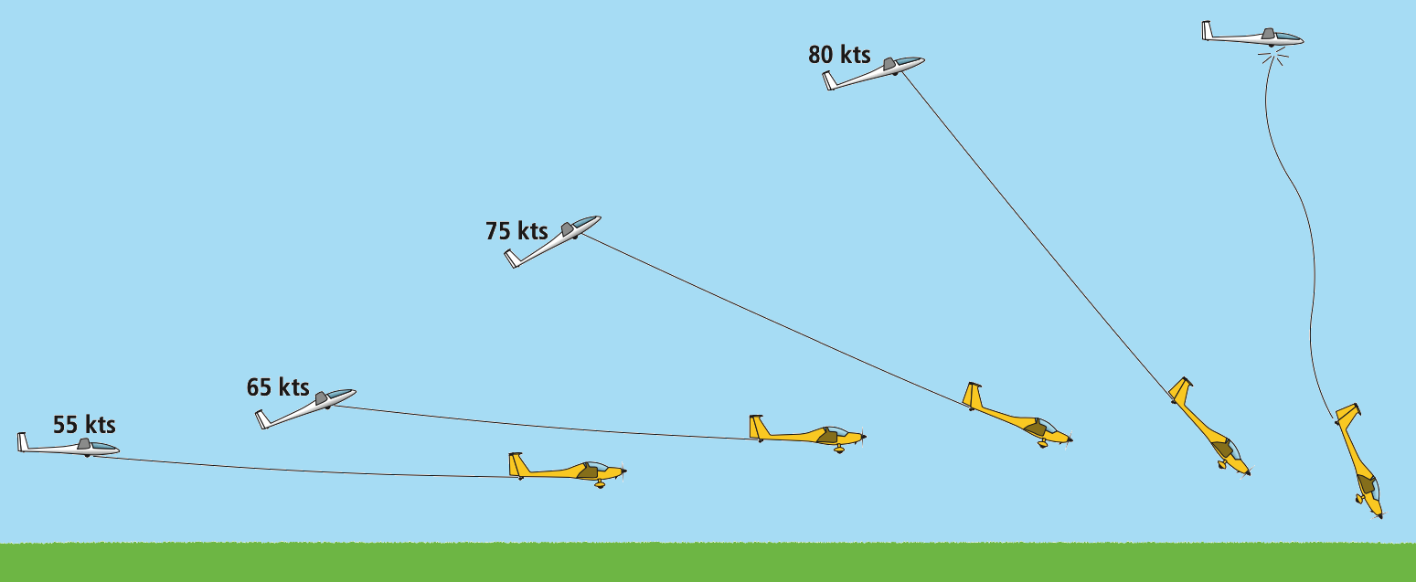

Slide 39
Why does the glider kite?
Angle of attack of the horizontal stablizer is set slightly negative
This imparts a tail down force (nose up)
As acceleration continues the tail is forced progressively down (nose up)

Slide 40
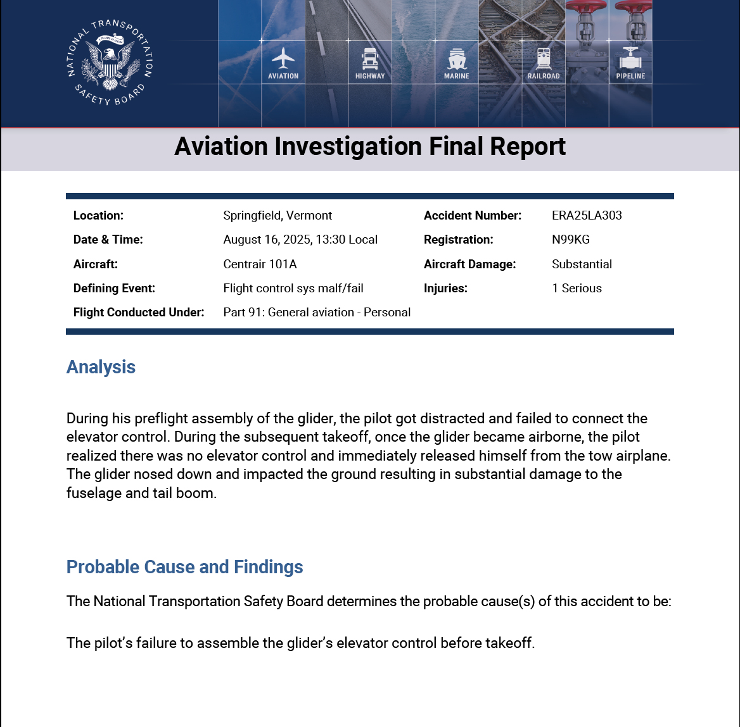

Slide 41
Take Off/ Premature Termination of Tow
Analysis: Pegasus Accident
Highly experienced professional pilot with multiple ratings
26,000 total flight hours
653 total hours in this make/model
Notes:
On its face this should never have happened.

Slide 42
Take Off/ Premature Termination of Tow
Analysis: Pegasus Accident
Distraction
Checklist Usage
Currency:
had not flown that glider at KVSF since May 6, 2023
last flight review or equivalent October 5, 2021
Critical Assembly Check and Positive Control Check

Slide 43
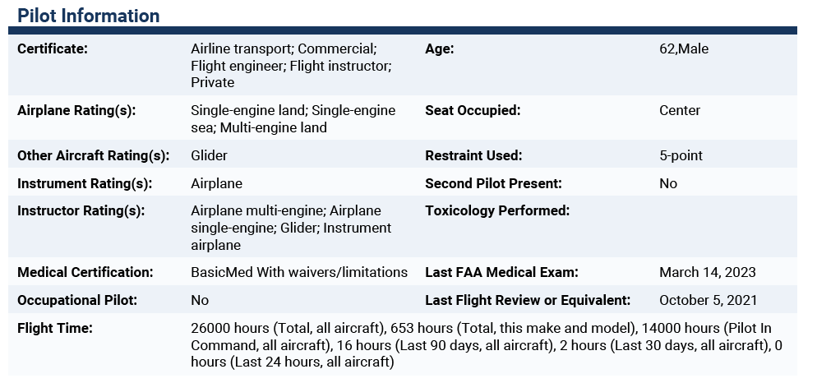

Slide 44
Operator/Owner Safety Recommendation (How could this accident/incident have been prevented)
“I should not have allowed myself to be distracted and immediately connected the elevator after installing the horizontal stabilizer.”
“A large “Positive Control Check” placed over the instruments until a PCC is accomplished.”
“A “Remove Before Flight” tab attached to the elevator or elevator pushrod.”

Slide 45
Operator/Owner Safety Recommendation
(How could this accident/incident have been prevented)
“Better training for ground crew regarding Critical Assembly Checks and Positive Control Checks made up mostly of students. I have been dubious of the knowledge of ground crew regarding safety checks for fiberglass gliders at our club.”

Slide 46
5 Hazardous Attitudes
Anti-Authority : disregard of rules, regulations and procedure
Impulsivity: act immediately without thinking through consequences
Invulnerability: happens to others, won't happen to me
Macho: I can do it; try to impress others or that they’re superior
Resignation: whats the use, nothing I can do

Slide 47
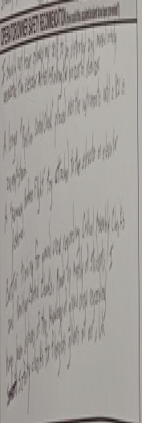

Slide 48
What went right?
Immediately released- This undoubtedly prevented a far worse accident and injury
Tow pilot had presence of mind to go to the gate to await/lead first responders to the scene

Slide 49
So what caused this event?
Complacency

Slide 50
T/O, PTTT
Take Away Thoughts
Takeoffs are optional…
The release is your friend if ANY abnormalities
Checklists for assembling and pre takeoffs
Glider Assembly is not a glider preflight

Slide 51
Take Away Thoughts
Guard against Distractions - have a mechanism flag the distraction then to return
Consider Emergency plan for runway/winds/terrain
Can all controls be easily reached and activated?
RELEASE!

Slide 52
Take Away Thoughts: NESA Specifically
We have no “trust but verify mechanism” currently with regard to pilot qualifications and currency.
Formalize an emergency action plan (who does what & when)

Slide 53
Should you be involved in an “event”...
Emergency care/safety
Review the NTSB requirements( 49 CFR Part 830) make reports if required
File “NASA” Report
Contact a flight instructor or a FAASTeam Rep to discuss the event
Get dual instruction with an instructor

Slide 54
We are all human…
Any one of us is capable of making mistakes and having a bad day.

Slide 55

Before you fly
Please Think...

Slide 56
Questions?
gsmithdmd@comcast.net

