Slide 1
Ground Operations Review
2026 Spring Safety Seminar

Slide 2
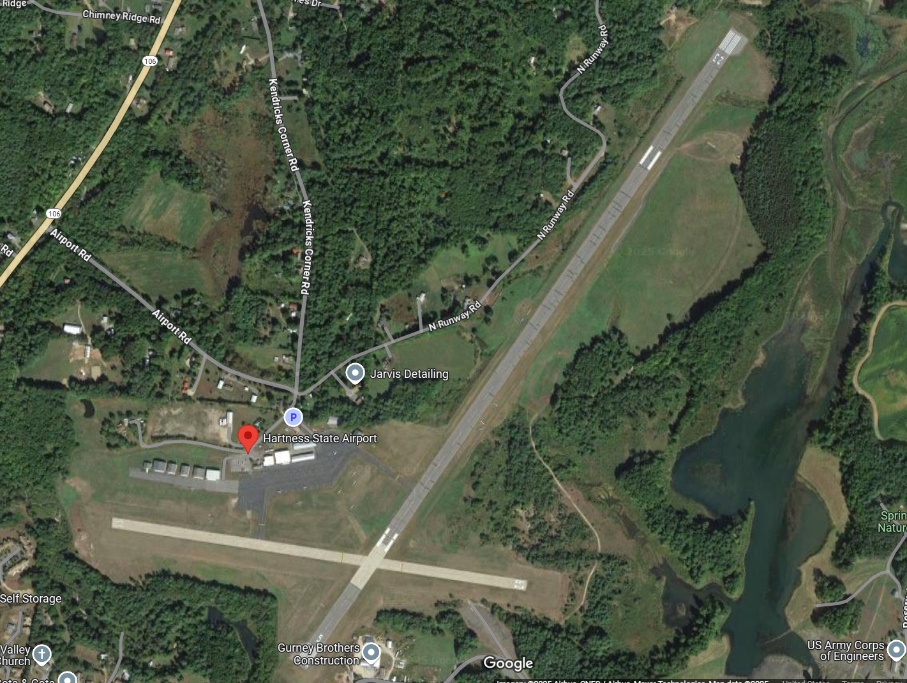
Dead Side
ACTIVE SIDE
05R / 23L
11R / 29L
29L

Slide 3
General Guidelines
We share the airport with Other users
Not exclusively glider ops. Please do not treat as if it is;
Work to not impede other users at any time
Do not block taxiways!
Trailer Parking
All Trailers must be far enough back that when fuselage pulled from glider tail is inside Taxiway lights
Rigging
No Rigging on Ramp that in any way intrudes on the taxiway areas of the ramp!
All Gliders require a daily Critical Assembly Check (CAC) by someone other than the pilot who assembled the glider. CAC not confirmed– no launch.
Tow Out and Staging
Ground Crew will ask you to confirm completion of CAC before they will tow you out.
Gliders may be staged in the grass off the DEAD SIDE of the runway or in Designated CUT-OUT’s only.
No Vehicles on Runways without prior approval by Daily Ground/Operations Manager
Tow-out’s will generally be by golf cart.
All tow-out’s must have radio and flashing lights (airport requirement)
Any traffic in pattern, cease tow-out and move gliders off runway to grass on DEAD SIDE

Slide 4
General Guidelines
Griding/Positioning for Take-Off
Move onto Runway surface (Hard or soft) only when clear to do so (pattern is clear);
All pre-flight items should be complete before positioning. Get in and be ready.
Communications
CTAF is 122.8
Launch and Landings will be conducted on CTAF
Relights
Landing behind Gridded Gliders on same surface is not permitted
Ensure at no time are both the Hard and Soft surfaces for a given runway both blocked.
Tow-backs After Landing
Gliders shall be cleared to DEAD-SIDE
Tow-backs shall generally by on DEAD-SIDE

Slide 5
General Guidelines
There are some Runway specific considerations to be aware of:
Runway Specific Considerations follow..

Slide 6
RW 5 Cautions
RW 5
Drop off on the approach end of RW 5. Do not attempt to land very short, often down-draft on approach.
Plan to roll-out beyond the far hold-short line for RW 11/29 so that you are not blocking that runway after landing and ideally finish at/near the taxi-way
If landing Grass (5 right) land beyond the cross runway and runway signs
Be aware of Runway lights! No student landings on RW 5R short of 29
RW 5 Gridding
Back of grid must be beyond 11/29 Hold short line. 11/29 shall be left with no encroachment at any time when using RW5
During Launch
No personnel or equipment allowed on East side of runway except in cut-out!
Relights
You can land on 5R grass if you have to. 29 or 11 is preferred. If landing 5R land beyond the cross runway.

Slide 7
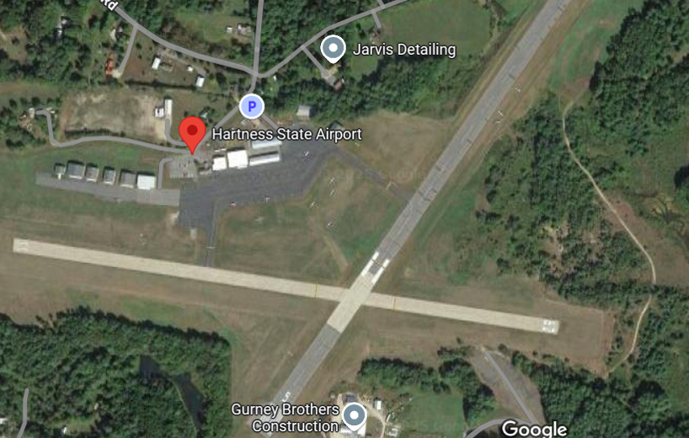
RW05 Operations
Staging areas
11/29 Hold Short Line. Grid forward from here leaving 11/29 open with no incursions
Tugs land on 11, 29 or 5 Right and taxi forward on grass to pull out in front of grid. Tug will not land on RW05R if there is a glider staged 05R

Slide 8
RW23 Operations
RW 23
Often turbulent on final with any cross wind due to hills on west side of approach end
Plan to land reasonably long and roll-out to the Taxi-way. It is a long runway, remember to make your base based on your aiming point not necessarily based on where the end of the runway is!
Left Grass is landable by 15m glider if needed. Always aim and land beyond where the grass widens out. The first 1000ft or so is too narrow.
RW23 Staging and Gridding
The front of the Grid will be at the north-end of the west side cut out and extending back from there
During Launch
No personnel or equipment on East side of the runway except to launch or retrieve.
Relights
You may land 23 Right on the grass. Roll-out beyond the front of the grid and expect to be pulled across to the west side for tow-back in the west side grass.
Also fine to land 11 or 29 and we will send a cart.

Slide 9
RW23 Operations
Grass widens out here
All landings must be beyond narrow section
West side Cut-out. Tugs stage here. Grid is from here back

Slide 10
RW29 Operations
RW 29
Big Drop off on approach end. Lots of sink. Keep base close in and use a steep approach. Don’t drag it in!
RW29 Staging and Gridding
Short Runway – We will grid one group at a time and keep remaining groups staged on north side grass
During Launch
No personnel or equipment on South side of the runway!
Relights
You may land on 29L Grass, 11 or 23. If landing on 29L. Touchdown and roll-out beyond the crossing runway 5. This leaves grass east of crossing runway open for tugs to land. Be aware of runway light dead-center on grass where it meets RW5

Slide 11
15m -If Landing Grass – land here!
Runway light

Slide 12
RW11 Operations
RW 11
Trees on Approach
People tend to want to stay too high above trees and land very long
Terrain and trees slope down to runway on final
RW29 Staging and Gridding
Short Runway – We will grid one group at a time and keep remaining groups staged on north side grass
During Launch
No personnel or equipment on South side of the runway except in cut-out!
Relights
You may land on 11R Grass, 5 or 23. If landing on 11R Touchdown stop before the intersection of RW5. Expect to be immediately pulled across to the north side for tow-back. We want as little time sitting on 11R as possible to allow tugs to land.

Slide 13
If Landing Grass – land here!

Slide 14
Relight Considerations
Land to be safe not to expedite your return to the grid. You are going to the back of the line anyway!
For landings on parallel grass to any runway be aware you will be (when safe) pushed across the pavement to be brought back to the grid on the dead-side grass. Be alert.
This is the downside of our layout – crossing the active paved runway for towback. Ground crew are aware and check traffic but help them – if you see anything speak up.

Slide 15
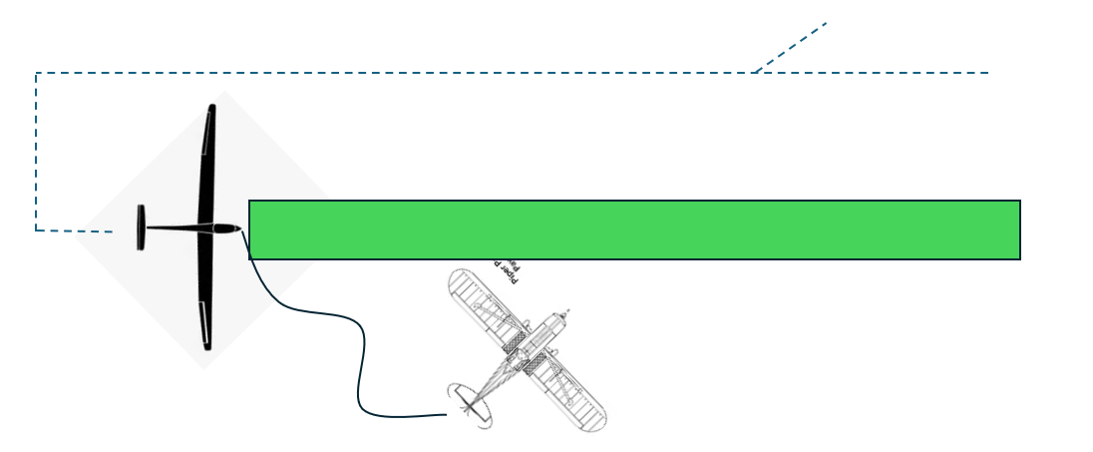
Towing Procedures
Tugs will park in the Cut-Out areas when shutting down.
When Ready to tow, tug will stage at an Angle to the take-off (see diagram) and to allow visibility to (i) pattern and (ii) line crew and hook-up process. Tow-pilot will not begin taking up slack until signal is given to do so by wing-runner.

Slide 16
Launch Procedure
Hookup
Do not hook-up glider before Pilot has completed his/her checklist and the canopy is closed
Hookup then immediately move clear of Wing
Do not pick up the wing
Check Pattern
Pilot asks “Is the Pattern Clear”
Wing Runner – looks around at full pattern for all runways. When confirmed respond “Pattern is Clear”
Take Up Slack
Wait for Thumbs up from Pilot
Only after thumbs up – Wing Runner will level wing and give take-up slack signam
Tow-pilot will not begin taking up slack until Wing is level
Launch
When Slack is out of rope – All will hold
Pilot Waggles Rudder (no need to slam against stops)
Wing-Runner gives launch signal

Slide 17
Summary
CAC’s and Positive Control checks must be confirmed before tow-outs;
Be alert at all times. Keep all personnel and equipment on the ‘Dead Side’ grass or in cut-out areas whenever possible;
Rember both the paved and grass surfaces are ‘Active runways’.
Never allow both the paved and grass surfaces for any runway to be blocked at the same time.
Relights – Land to be safe not to expedite – you are going to the back of the line anyway.
BE SAFE
DON’T MAKE JUNK!

