Slide 1

NESA
Spring Safety Meeting 2026
Instruction and Airport Safety

Slide 2
Safety is everyone’s job
No “Safety Officer” in our Club
Our Constitution:
  “The purpose of this organization shall be to advance knowledge and safety …”
  “The Chief Flight Instructor shall be responsible for… enforcing safety on the field. He will also establish and post safety rules…”
I need your help!
Notes:
The word “safety” only comes up 4 times in our Constitution. Once right at the beginning…

Slide 3
Get Your Head Back in the Game
Wings and Wheels Newsletter – April 2
  Stay within your abilities—and be honest about where those limits are today, not where they were last season.
  Build margin. Ask questions. Make independent decisions.
  That’s how you stay safe—and keep flying.
Notes:
“You are not as current, not as quick, and not as sharp as when you last put the glider away. That’s normal—but it needs to be respected.”
With that in mind – what are some things you can do now – before we start flying…

Slide 4

Review your logbook
Notes:
If this looks familiar – this is cribbed from Jerry Smith’s presentation in 2021

Slide 5
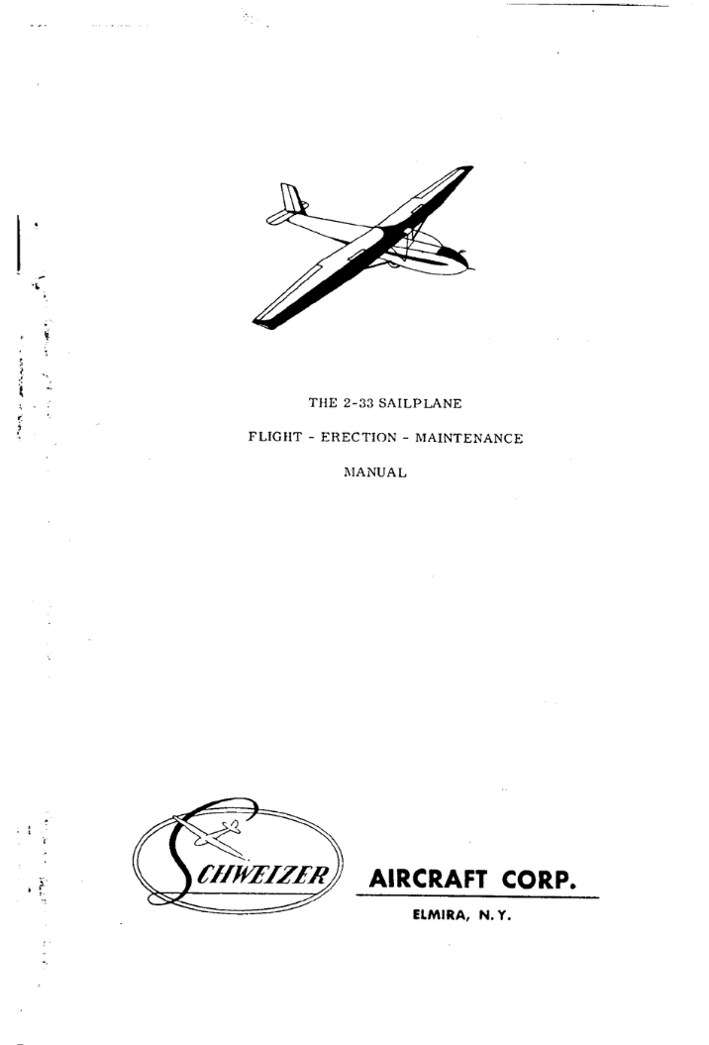
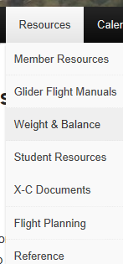
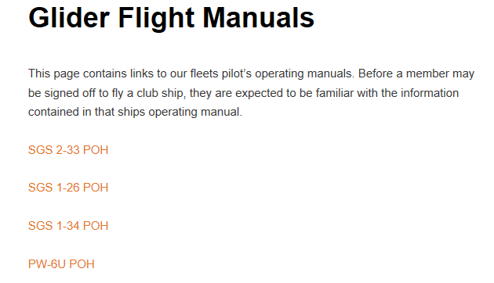
Review your Flight Manual
Notes:
Speed flashcards?

Slide 6
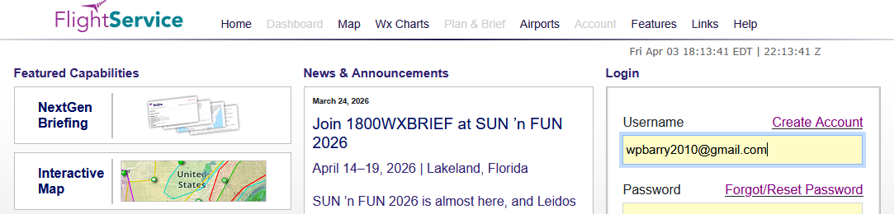
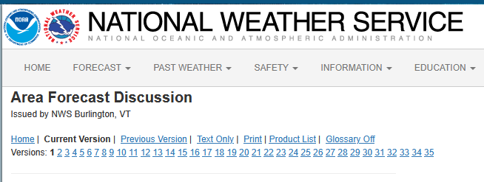
Check the weather and Notams
– at home
www.1800wxbrief.com
NWS Area Forecast Discussion
Notes:
Notams, TFRS, NWS Area Forecast Discussion, Weather Underground, Windy or Ventusky, or….
Build a list AND a habit - now

Slide 7
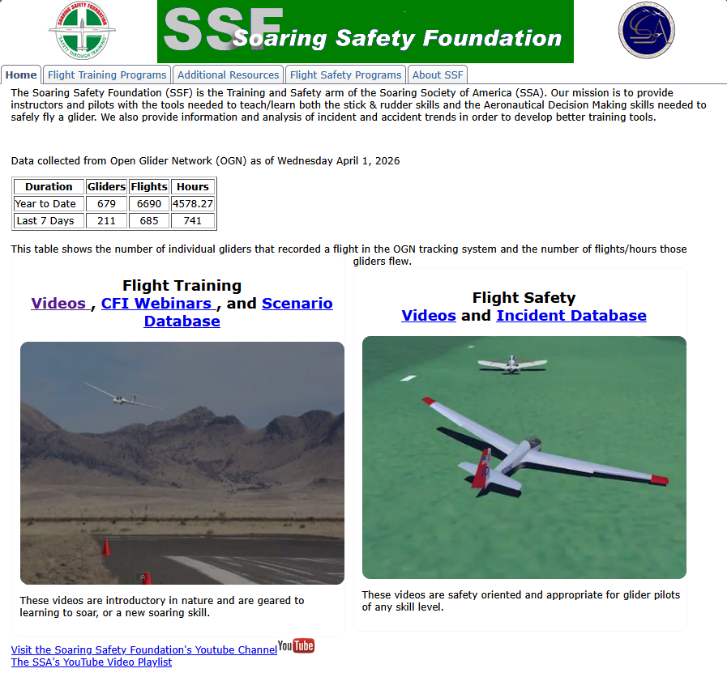
Online Study
WWW.SOARINGSAFETY.ORG
Notes:
Don’t forget the Wing Runners course here.

Slide 8
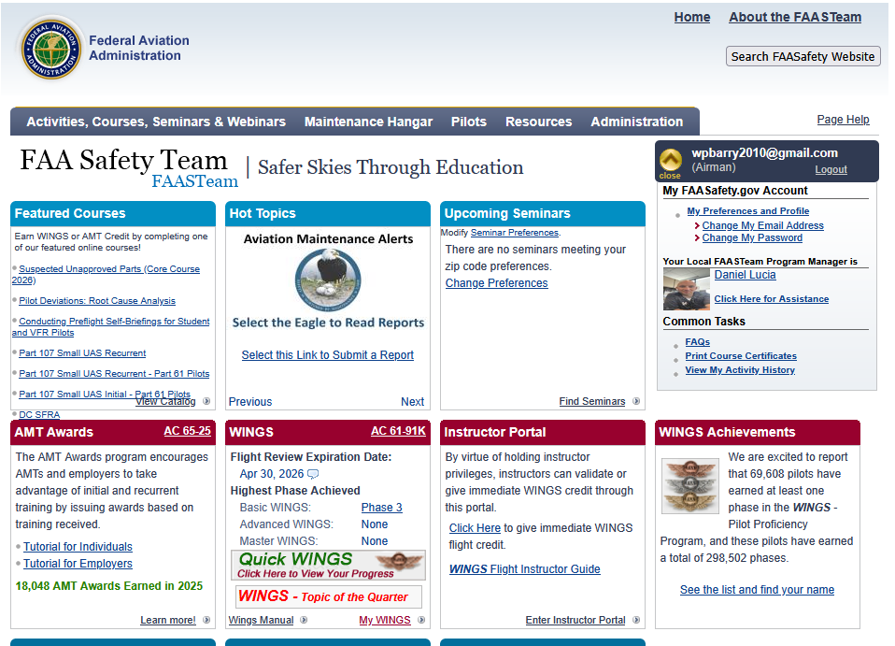
Online Study
WWW.FAASAFETY.GOV
Notes:
Wings program is awesome – even an easy way to get your flight review done. Get credit for all sorts of things – like badges, etc…

Slide 9
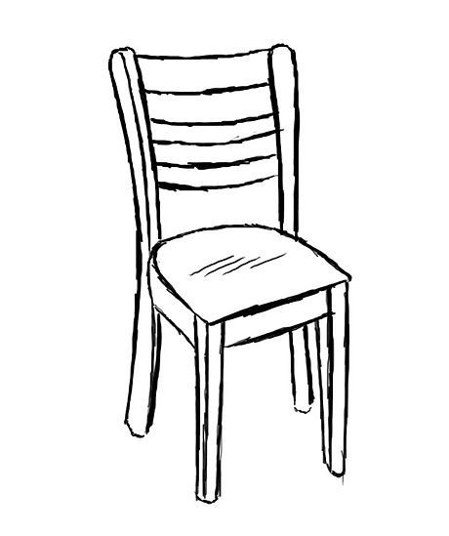
Chair Fly
Notes:
Simple but highly effective.
Procedure diagrams?
Flash cards?

Slide 10
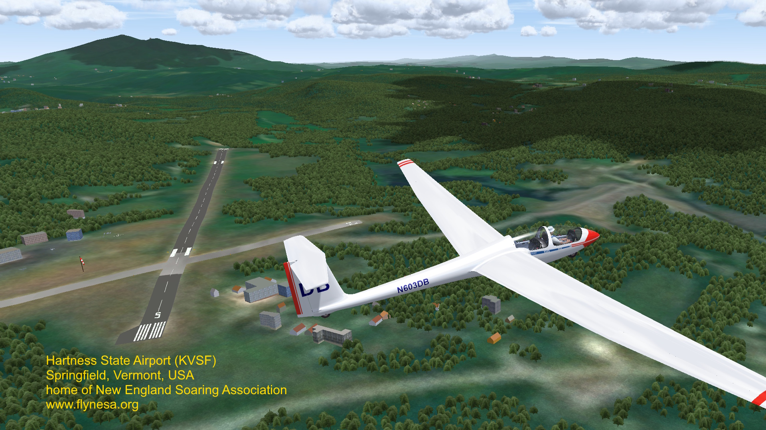
Condor
Notes:
Great to fly when you can’t – don’t play, treat it like a real simulator. Do checklists, set rope break %, fly pattern tows.
Now, in Condor 3, you can fly with someone else in the backseat (maybe a CFIG).
And there is a whole flight school course (actually 2 of them) available free from SSA.

Slide 11
During the Season?
Ways you might contribute to safety for all of us:
  Ground Ops duty
  Line Crew duty
  Pay attention on the flight line – esp. with visitors
  Drive golf carts responsibly
  Use our Safety Management System… (huh?)
Notes:
Once we get flying – How can you do your part?

Slide 12
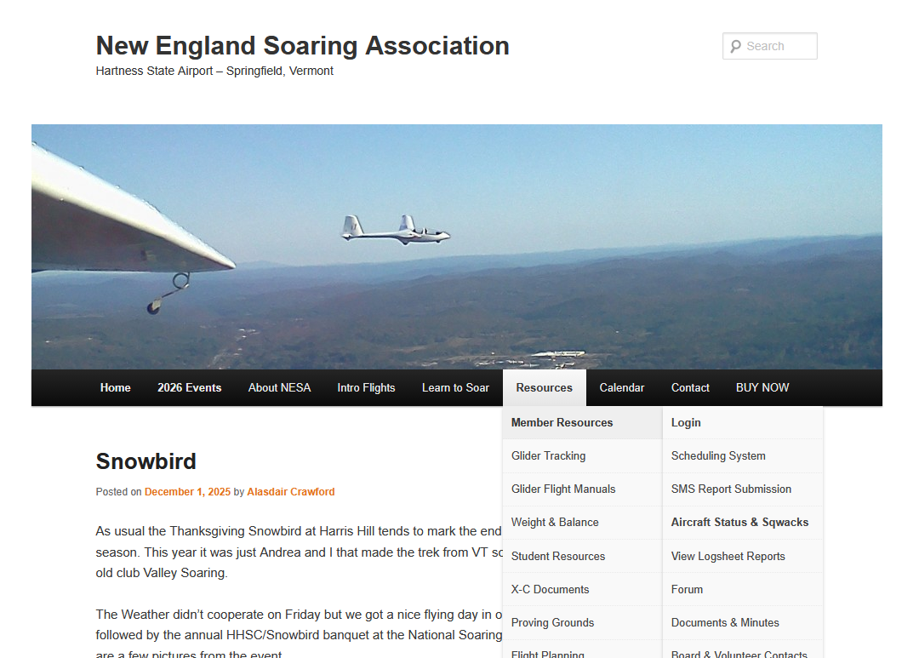
Notes:
A capability that every club should have – we have it – does anyone use it?
Not just to report problems – but to build a positive safety culture. Re: FIRC – Richard Carlson’s Safety 3.

Slide 13
Improving Ground Ops Safety
Why not look for ideas from others?
  Other clubs you may have been in
  Other types of operations that might have lessons for us
  Even other things done here at Hartness… (over to you Alasdair)
Notes:
[Make the request…] send me manuals or briefings or…
I’ve asked Alasdair to talk about how ground operations ran at our very successful Cross Country Camp last year.

Slide 14
Questions / Discussion

