Slide 1

NESA Spring Safety Meeting 2026
Tow and Instructor Scheduling

Slide 2
2025 Season
In 2025:
~17 “learners”
8 very active instructors
Tow & instructors assigned for each day at the start of the season
Many weekend days we were able to add an instructor to teach up to 8 learners

Slide 3
2026 Season
In 2026:
Anticipating about the same number of learners
6 instructors, some with reduced availability, impacts tow pilots too
Result: lots of holes on the schedule

Slide 4
Dealing with the shortfalls
Instructors & Tow Pilots encouraged to fill in the gaps when able
Looking for additional volunteers
Other options considered…
“Instruction Wanted” limited to 4 on days when IP available.

Slide 5
How you can help
Sign up for instruction NLT Wednesday
don’t wait until Friday
Please – don’t hog the slots
One day per instructional weekend to start
If there are unclaimed slots on Thursday, then you can sign up for a second day (when available)

Slide 6
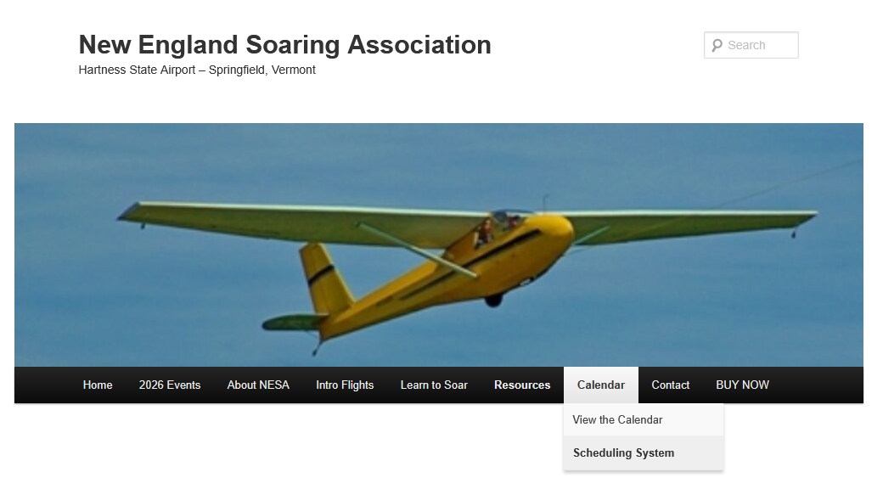
Scheduling Website
Notes:
Several ways to find it - click here, enter password

Slide 7
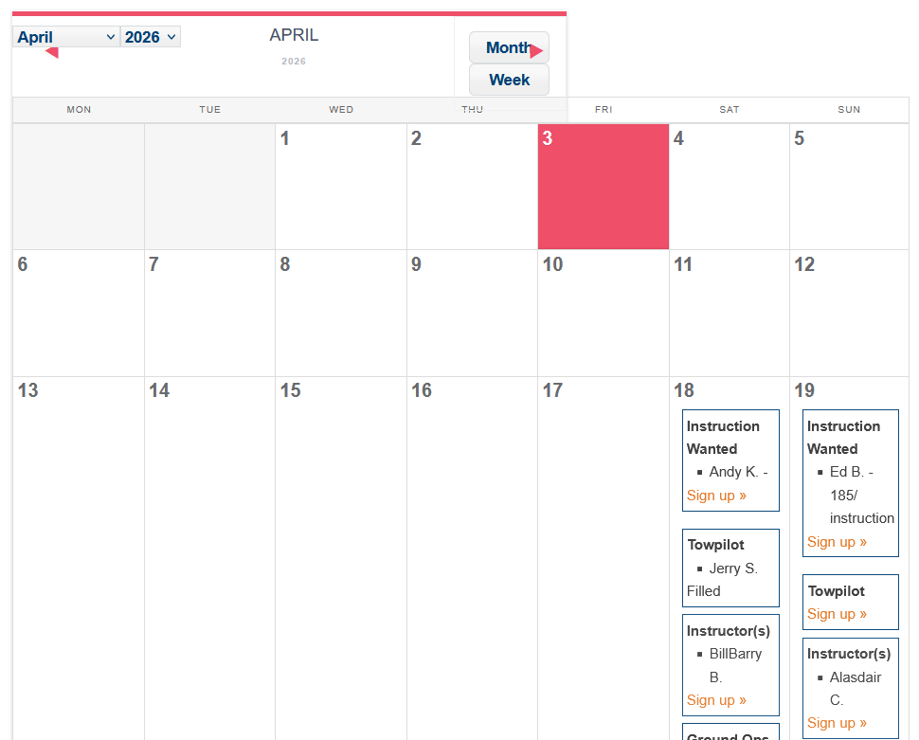
Scheduling Website
Notes:
Click on “Sign Up” and follow the prompts
Note: no towpilot yet on April 19

Slide 8
Another Change
In the interest of improving safety our Board has approved another change in scheduling.
On flying days there will now be 2 “Ground Ops” slots to fill.
Morning and Afternoon
Procedures and staffing left safety oversight to the duty instructor
We need more effective oversight than that
Ground Ops person will ground operations, line crew activities, and logging.

Slide 9
Line Crew
Separate sign up for Line Crew
Responsible for getting gliders into launch position and making the launch happen.
Responsible for retrieving landed gliders and getting them back to launch position.
Looks like one sign up slot, but this isn’t a single person job.

Slide 10
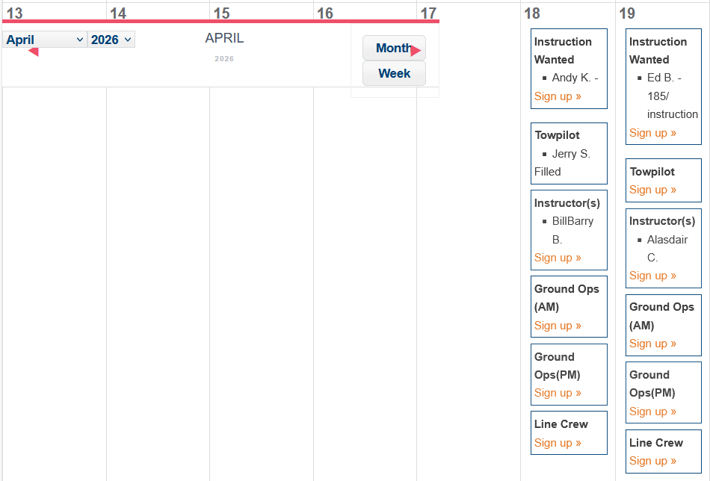
Notes:
Here’s what it looks like.

Slide 11
How do we make this work?
All club members should help.
Take a Ground Ops slot for half a day, fly the other half
No half day distinction for Line Crew, but you could do the same.
Learners signing up for instruction should also sign up for a spell as Line Crew or Ground Ops – once qualified.
CFIGs are working on training materials
Meanwhile – take the SSF Wing Runner Course online

Slide 12
Questions?

Slide 13
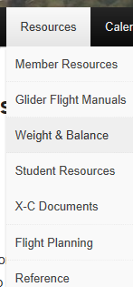
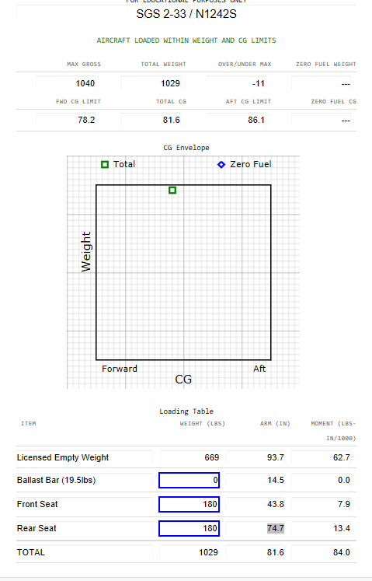
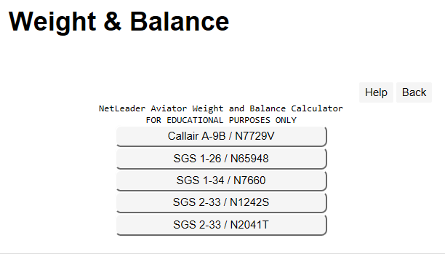
Website Tools:W&B Calculators

Slide 14
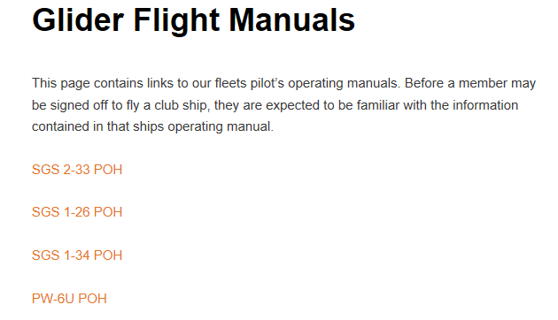
Website Tools: POH’s

